Slide 1
Large Language Models
Ryan Daniels
Senior Machine Learning Engineer
Accelerate Programme for Scientific Discovery

Slide 2
What does AI mean to you?

Slide 3

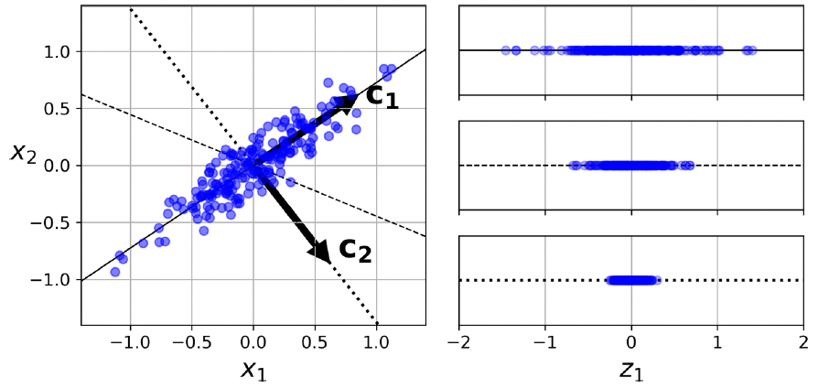
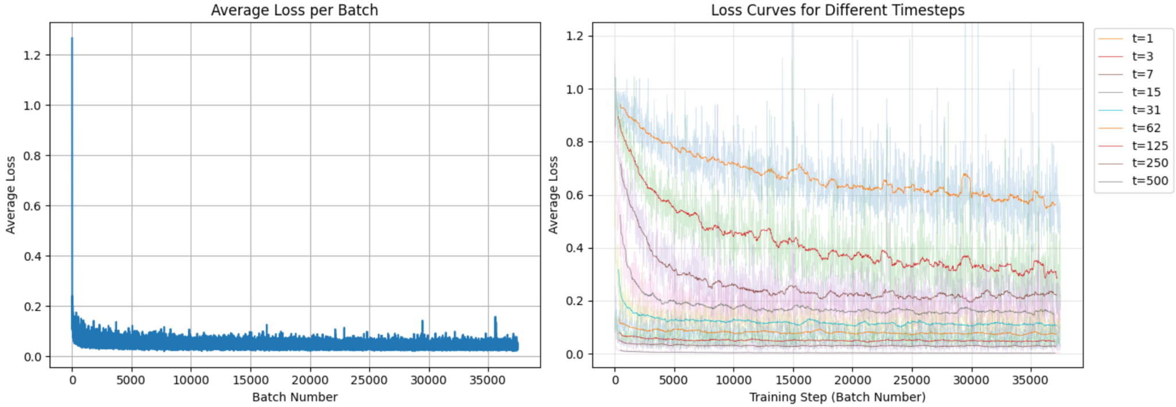
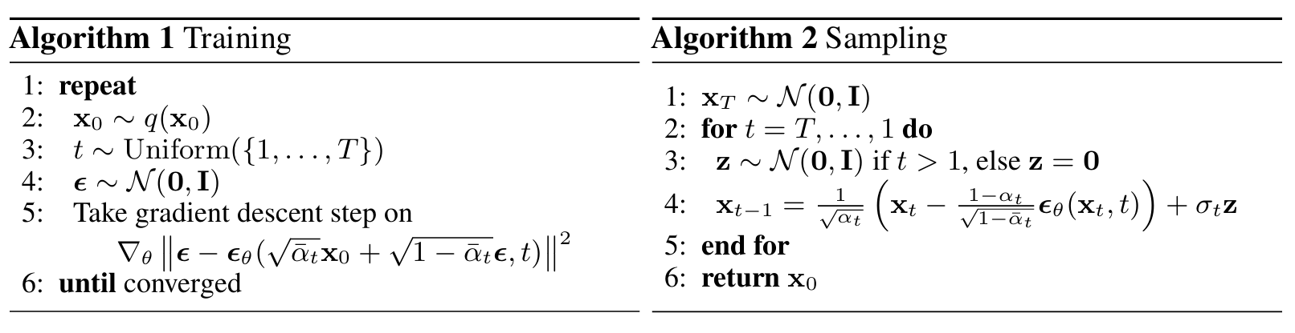
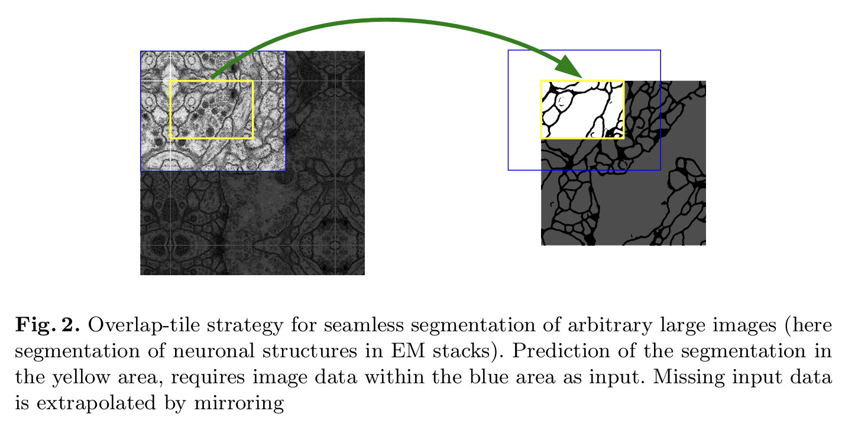
What AI means to me
Notes:
The thing is: lots of people, and companies want us to think that nobody can do what they can do.
This was actually expressed by Sam Altman a while ago, when he basically said that smaller groups simply cannot compete with OpenAI when it comes to training foundation models.
Part of this is also expressed in the nature of the papers that are published - they are all steeped in this mathematical language; they seem inaccessible to people who are not mathematicians and computer scientists; we don’t have access to millions of dollars of computational resources.
So instead, they just say to us, don’t worry about it.
And I think I disagree with this sentiment. And hopefully after this, so will you

Slide 4
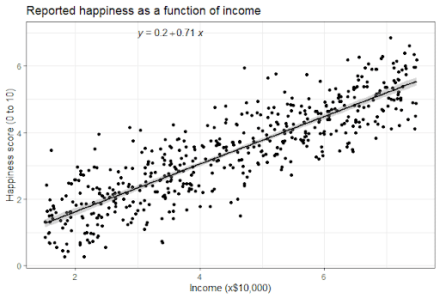
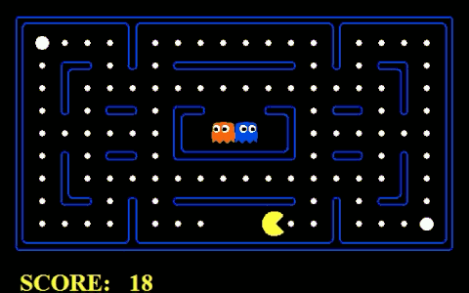
What AI means to me
Rule-based
Data-based

Slide 5
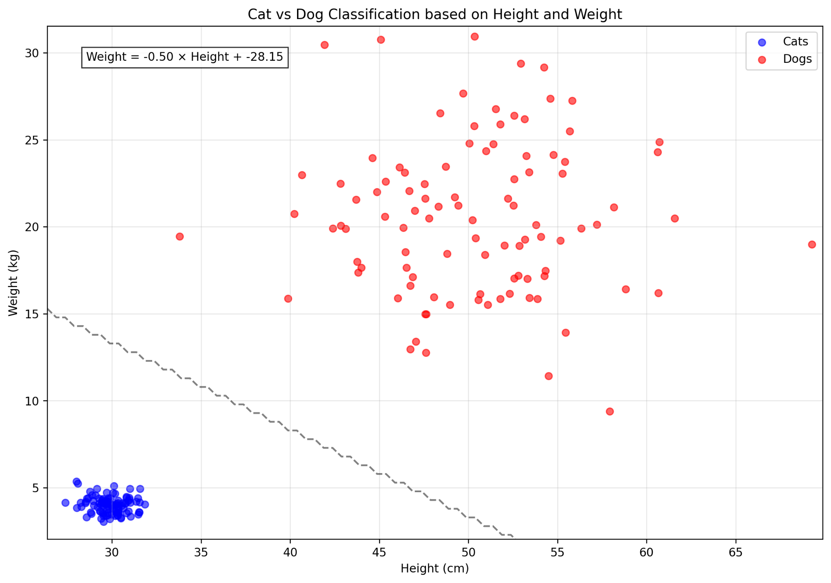
What AI means to me

Slide 6
LLMs
The important bits

Slide 7
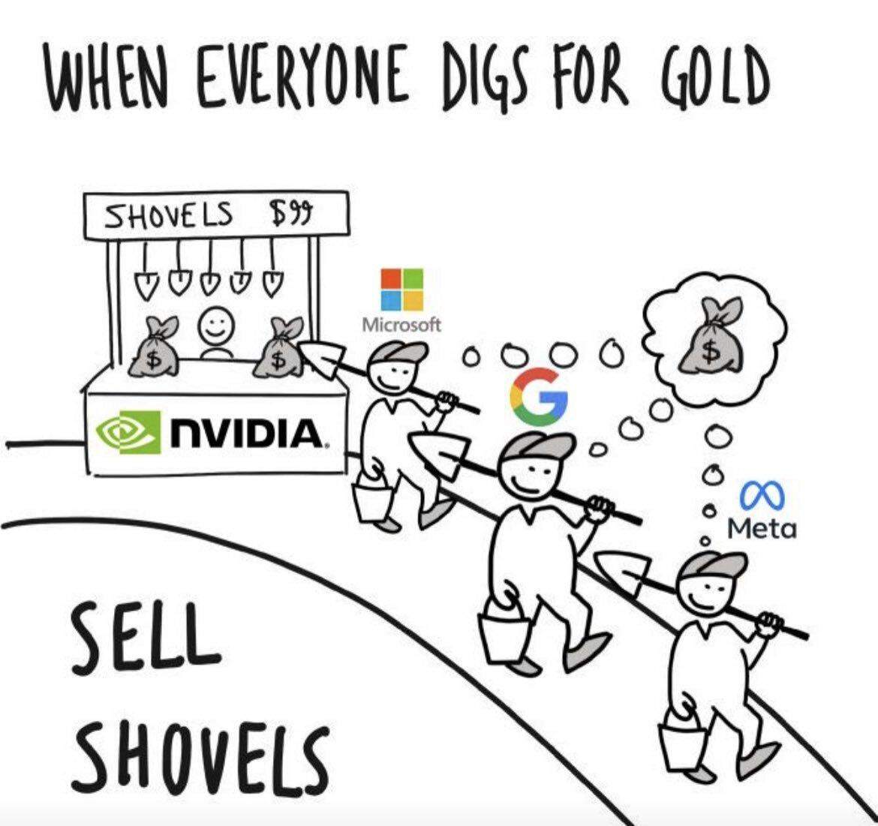

Slide 8


Slide 9


Slide 10
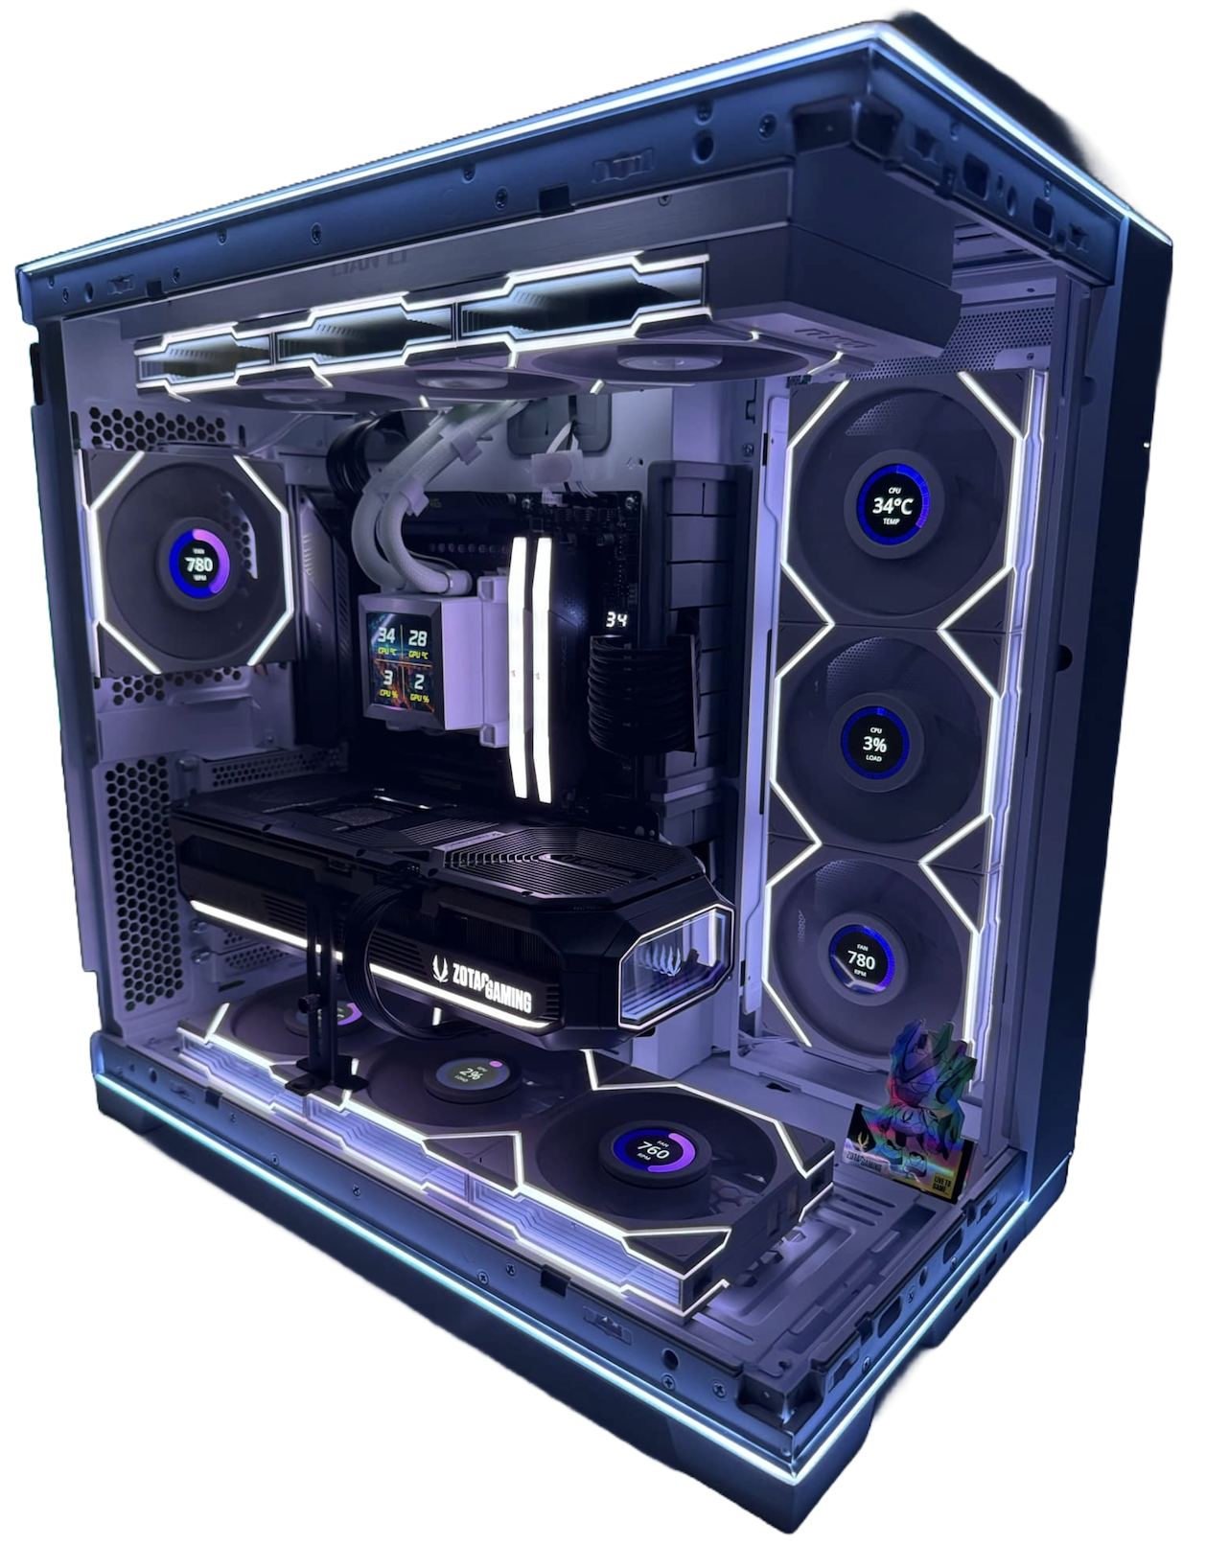

GPUs
Notes:
Just under 1million NZD

Slide 11
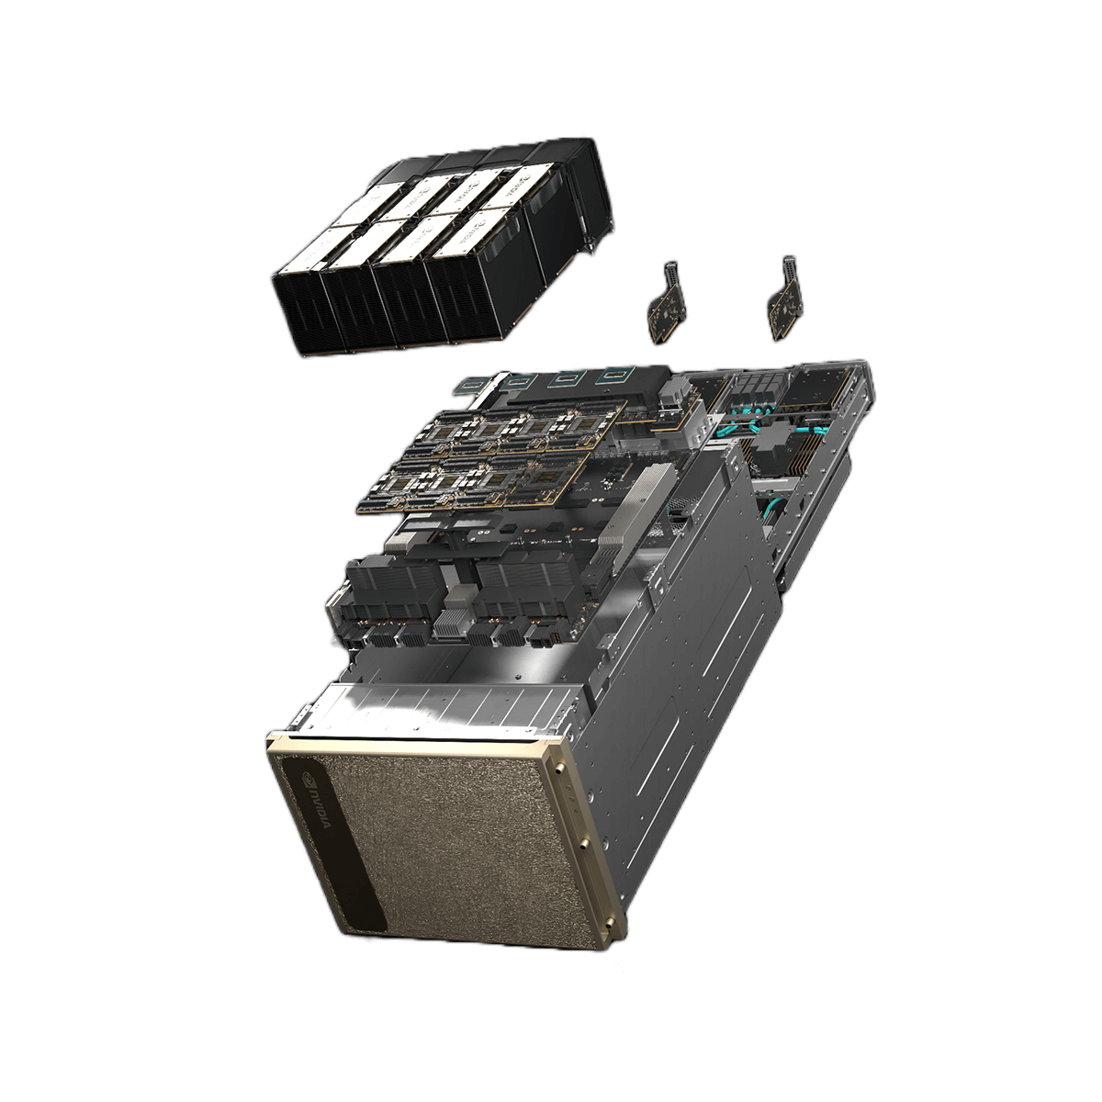

GPUs
Notes:
xAI bought 12,000 of these

Slide 12
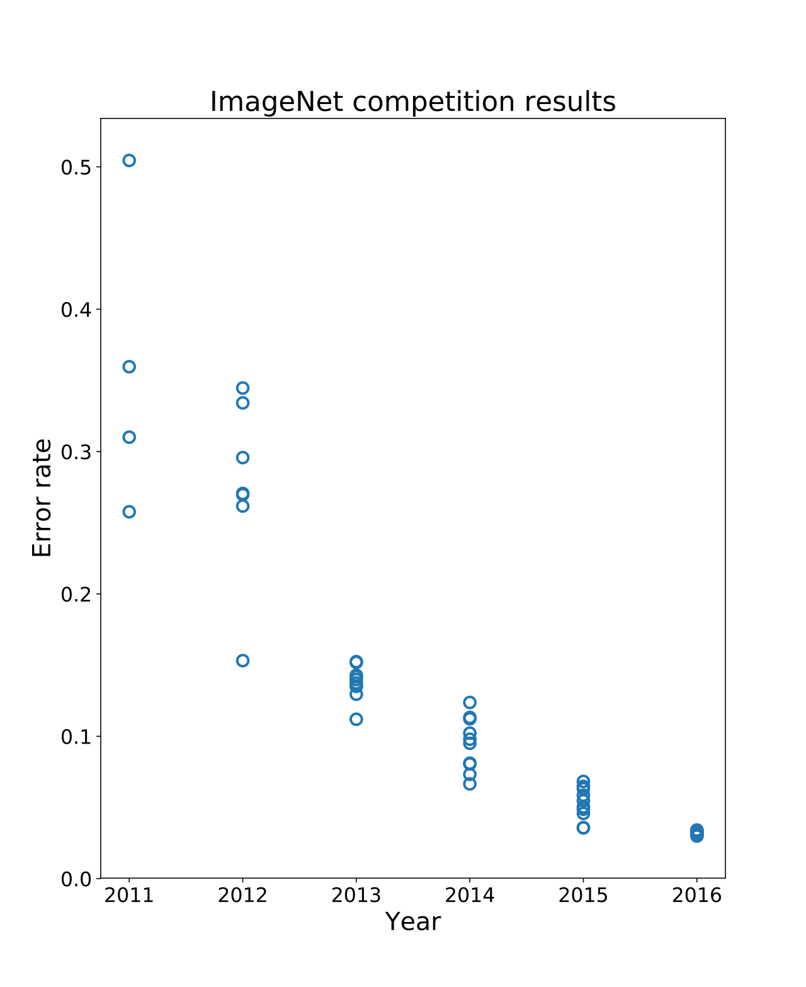
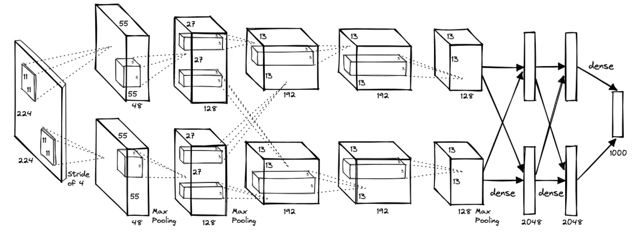
Milestone #1
AlexNet

Slide 13
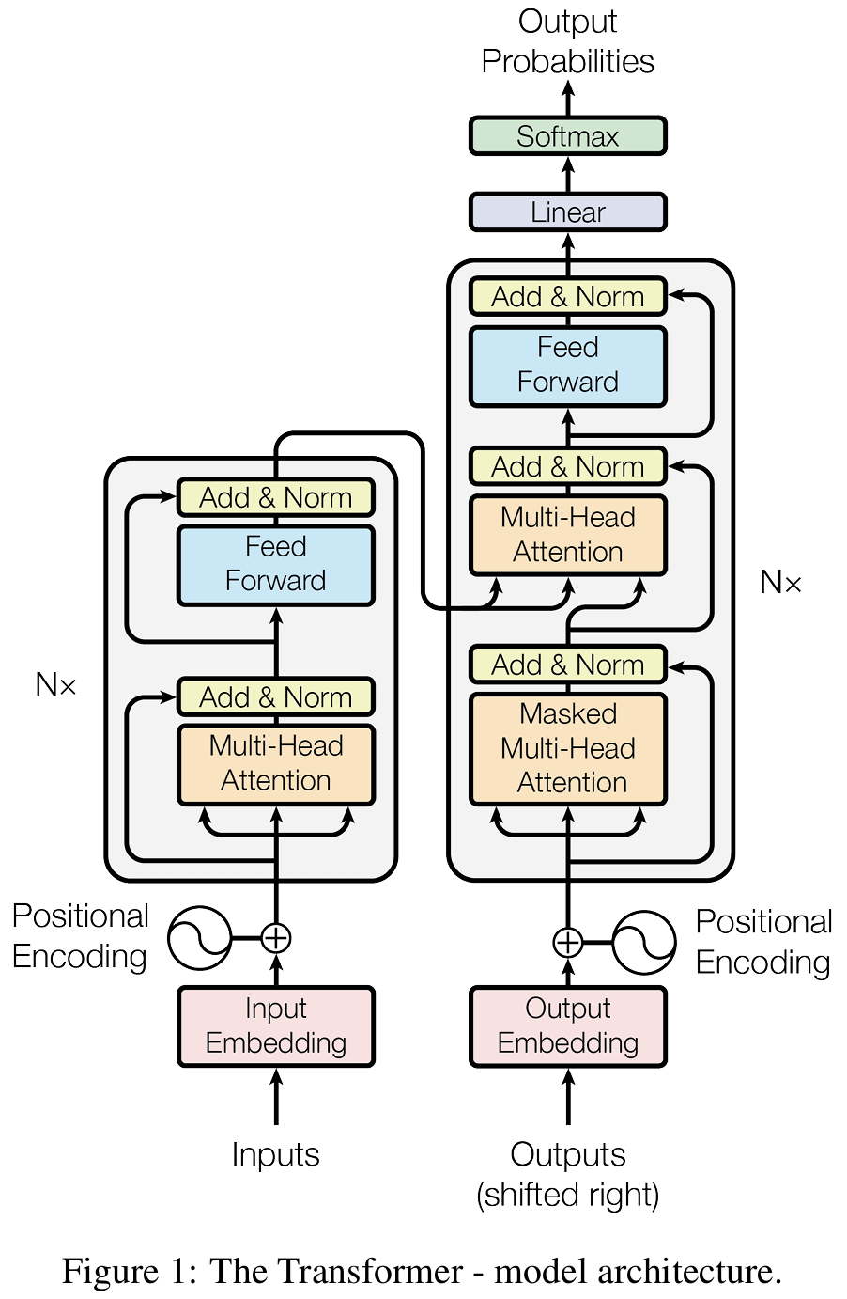
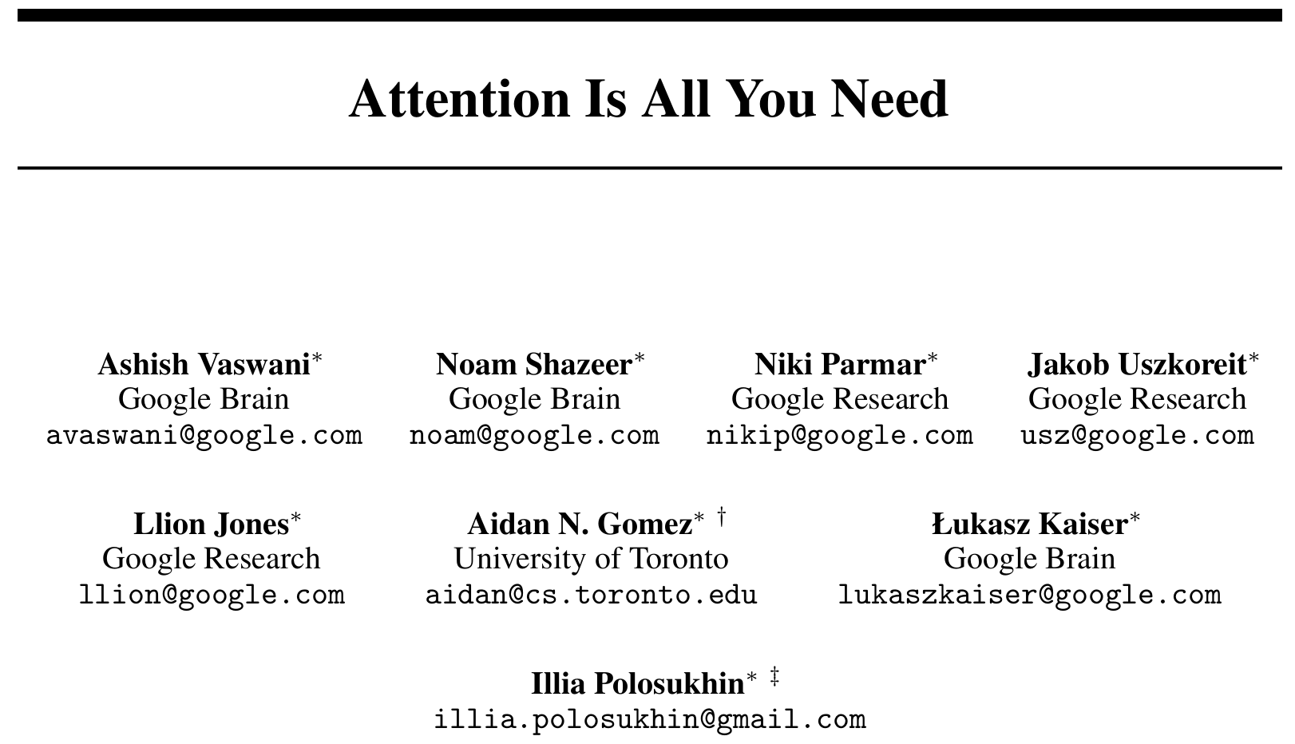
Milestone #2

Slide 14
The Semantic Alignment Problem
Model | A parameterized function that maps input text sequences to output text distributions. It has billions of parameters that are optimized by minimizing a prediction loss function over a massive corpus of text. | ChatGPT Claude Gemini
Learning | Synonymous with training – the process where weights are systematically modified through algorithms like gradient descent to minimize some objective function. | Recognition of preferences, adaptation of the writing style, and recall of previous information.
Context | The input to the model. | Important information that might be necessary to perform a certain task.
Notes:
Another thing that I want to address, is this idea called the semantic misalignment problem
What do we really mean when we say Artificial Intelligence (AI)? Ask a machine learning (ML) engineer or computer scientist, and they will likely describe a toolbox of algorithms, models, and mathematical techniques like regression, clustering, and neural networks, all wrapped in the dense language of probability, and implemented in code. Ask someone outside the field, and they will surely envision ChatGPT or Midjourney - complete applications with interfaces, memory systems, and in some cases, seemingly human capabilities.
And this is more fundamental than just the words that we use - we don’t even have a coherent conceptual framework for talking about intelligence across biological systems, machine systems, and hybrid systems.
Two stories that highlight this issue

Slide 15
The Projects
Notes:
For the remainder of this session, I want to focus on two projects.
In working through these projects, I hope to demonstrate firstly how language models work under the hood in the context of certain tasks. And secondly, how the researchers involved in these projects achieved their goals.

Slide 16
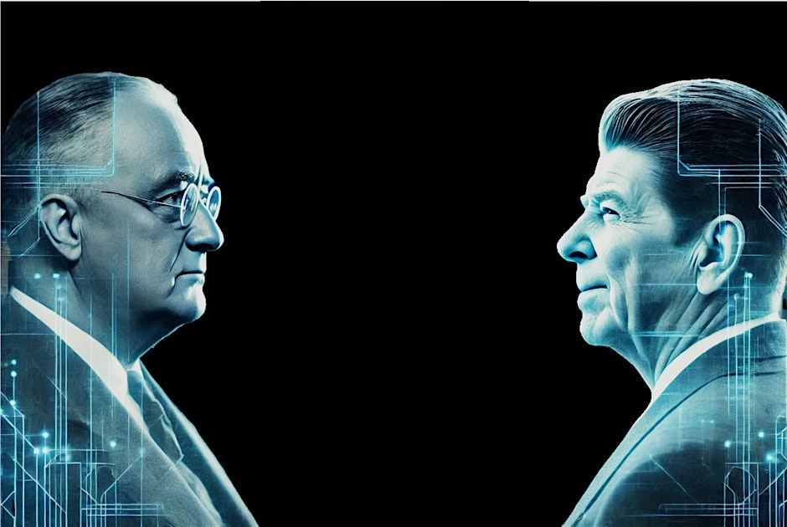
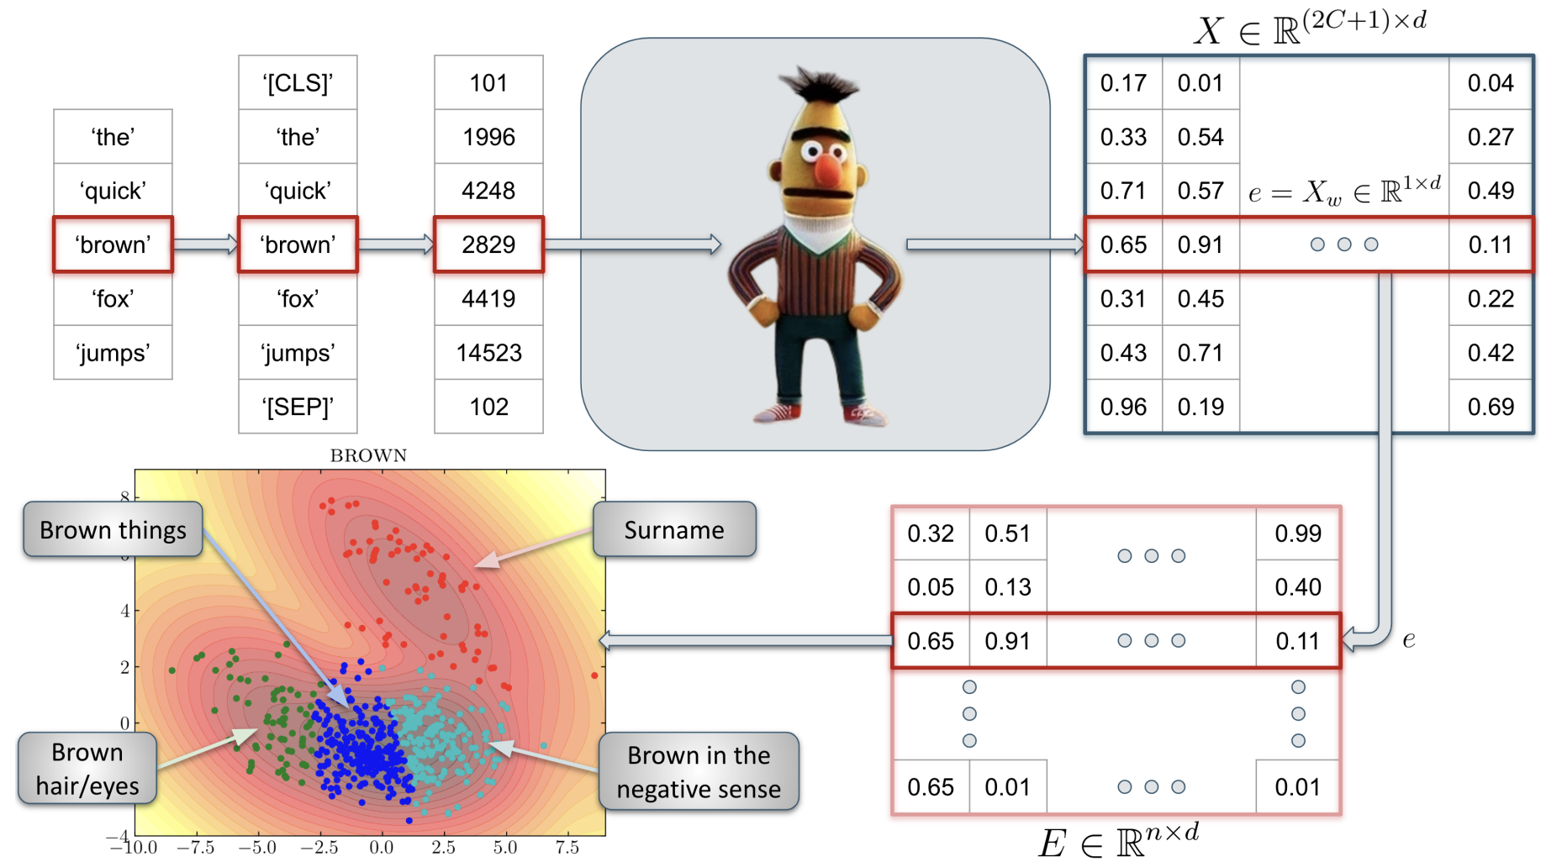
Two Projects
‘BERT's Conceptual Cartography: Mapping the Landscapes of Meaning’, N. Haket and R. Daniels, arXiv:2408.07190
‘Speaking with our Sources’, J. Forward and R. Daniels
Notes:
There are two main projects involving language models that I want to talk about today, and they both highlight a different use of language models.
The first

Slide 17
BERT’s Conceptual Cartography
How we use words in real speech

Slide 18
The Task
Nina Haket - Department of Modern and Medieval Languages
BNC14-Spoken Corpus
1,251 conversations
672 speakers
11.5 million words
How do people use words in everyday life?

Slide 19

Initial attempt
Here are some dictionary defitions of the word “bank”:
bank. n. financial institution
bank. n. the side of a river
…
Please give the appropriate definition for the following usage:
“I need to go to the bank to deposit some money.”
1

Slide 20
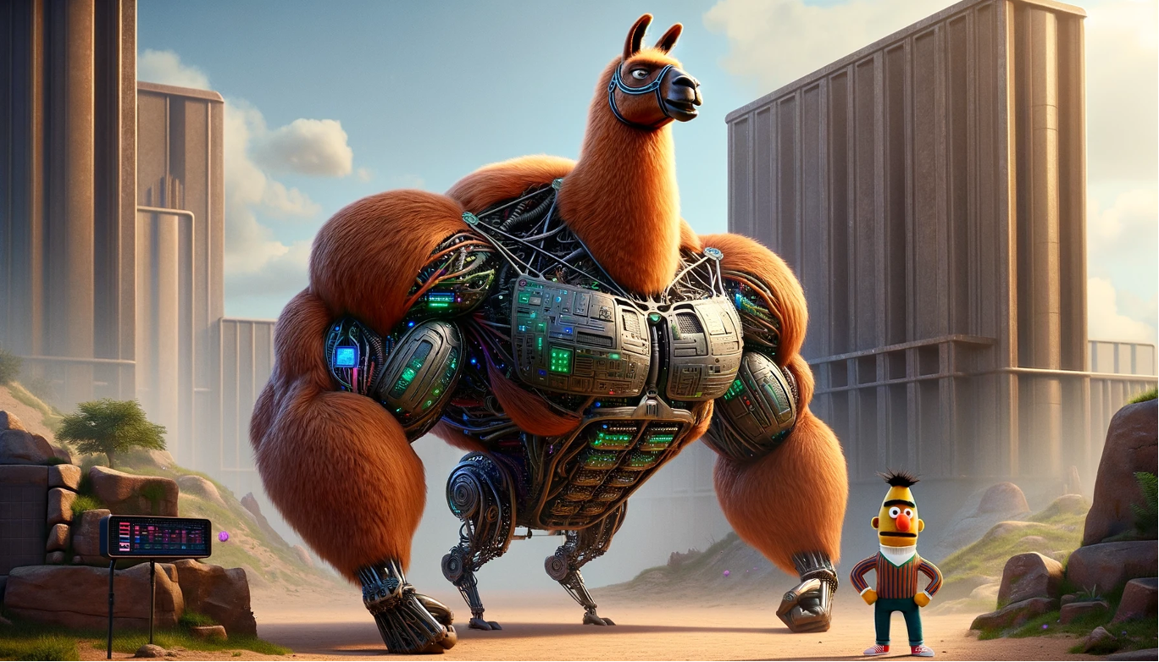
Who or what is BERT, and why is he/it useful?
Notes:
This image demonstrates two types of models:
On the left, you have the hulking beast of a Llama model - a massive 70b or 405b parameter model.
On the right, you have little old BERT.
These models are both transformers. They are both language models. And BERT would have been considered a “large” language model, when it was conceived in 2018, with 108M or 334M parameters, depending on the model. That means it takes up around 200-600MB in RAM.
BERT
BERT is a Bidirectional Encoder-only model. In the LLM space, you’ll have words thrown around like encoder, decoder, autoregressive model.
So what does BERT Do? And what makes it different from ChatGPT?

Slide 21

Llama
Large Language Model Meta AI
‘<bos>’’
‘the’
‘cat’
‘sat
‘on’
‘the’
‘mat’
‘<eos>’
101
1996
4937
6583
2006
1996
13523
102
‘the’
‘cat’
‘sat’
‘on’
‘the’
‘mat’
‘mat’ | 0.19
‘dog’ | 0.14
‘hippo’ | 0.07
‘was’ | 0.000001
Notes:
ChatGPT and other “generative” models, are next token predictors. In other words, given some input tokens for example, “The cat sat on the”, then what is the next token. We’ll come back to this later.

Slide 22

BERT
Bidirectional Encoder Representations from Transformers
‘[CLS]’
‘the’
‘cat’
‘[MASK]’
‘on’
‘the’
‘mat’
‘[SEP]’
101
1996
4937
103
2006
1996
13523
102
‘the’
‘cat’
‘sat’
‘on’
‘the’
‘mat’
‘sat’ | 0.19
‘was’ | 0.14
‘lay’ | 0.07
‘hippo’ | 0.000001
Notes:
BERT is what we call a masked token predictor. Here we have the same example. Except this time, we have masked the token “sat”. The job for bert is to predict this masked token. You see on the right, lots of different options. BERT will actually predict the probability of every possible token being the next token. So let’s say each token is a word, and suppose there are 200,000 words to choose from, then you’ll end up with 200,000 numbers. And the biggest number is the most likely next token. We’ll come back to this right hand side. But first I want to look at what’s going on in the left hand side.

Slide 23
Tokenization

Slide 24
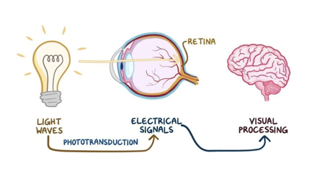
Tokenization
“the cat sat on the mat”
Notes:
Think of this phrase. What actually happens when you read this o the screen.
There is an equivalent process that happens when you hear it. Just replace the eye with the complex fourier transform that happens to convert the sound waves into electrical signals.

Slide 25


Slide 26
Tokenization
The machine starts from scratch…
text = "the cat sat on the mat"
tokens = ['the', 'cat', 'sat', 'on', 'the', 'mat']
map = {'cat': 0, 'mat': 1, 'on': 2, 'sat': 3, 'the': 4}
tokenized_text = [4, 0, 3, 2, 4, 1]
Notes:
So we need to convert these words to numbers.
Incidentally, there is an argument made that goes something like:
“An LLM is different from a human, because it can’t understand text, it can only understand numbers.”
And I think there is a strong conflation between what we consider as the model, and the model plus the infrastructure that exists to support the model. Which is going to come up again.
Because if we think about what we encountered when looked at human preprocessing, our “model” doesn’t work with words either, it works with electrical signals - there is a bunch of preprocessing that has to happen before the concept of a cat sitting on a mat becomes available to conscious attention.
Anyway, here we have used an example sentence.

Slide 27
Tokenization
We could tokenize by character instead of by word…
text = "the cat sat on the mat"
tokens = ['t', 'h', 'e', ' ', 'c', 'a', 't', ' ', 's', 'a', 't', ' ', 'o', 'n', ' ', 't', 'h', 'e', ' ', 'm', 'a', 't']
…maybe not…

Slide 28
Tokenization
We use BPE tokenization
…instead of whole words or individual characters, we look at subwords…

Slide 29
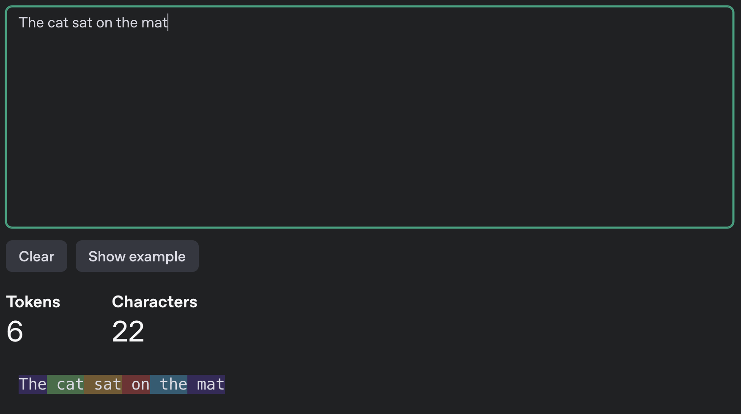

Slide 30
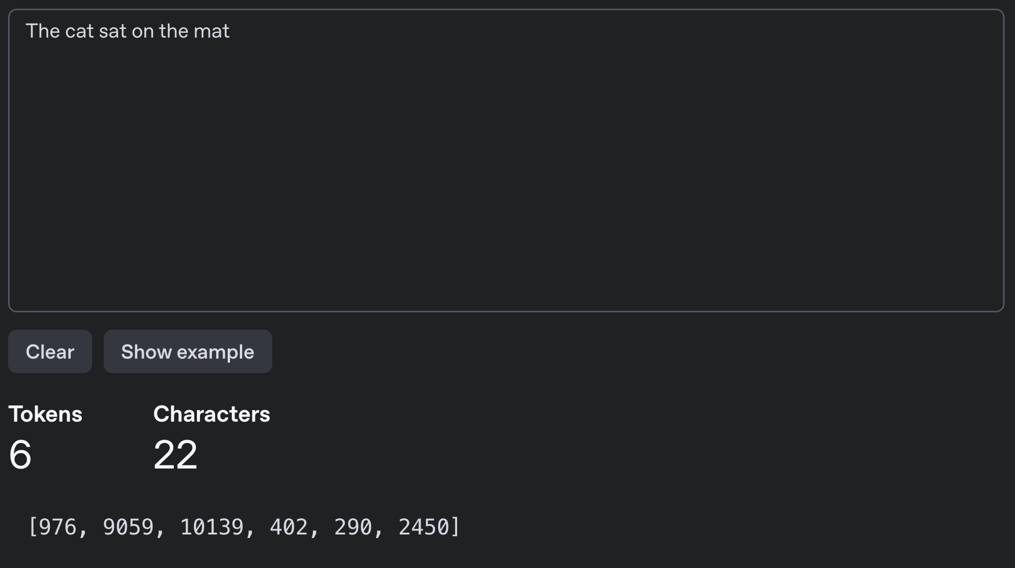

Slide 31
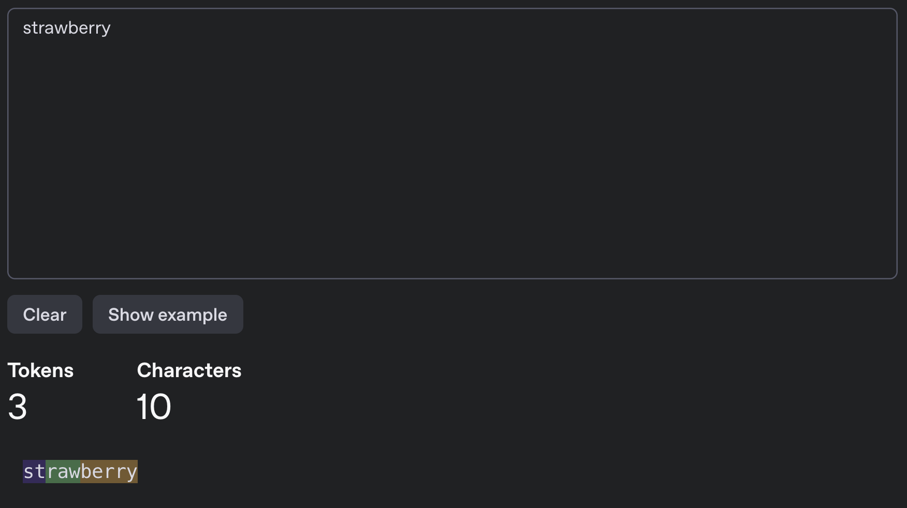

Slide 32
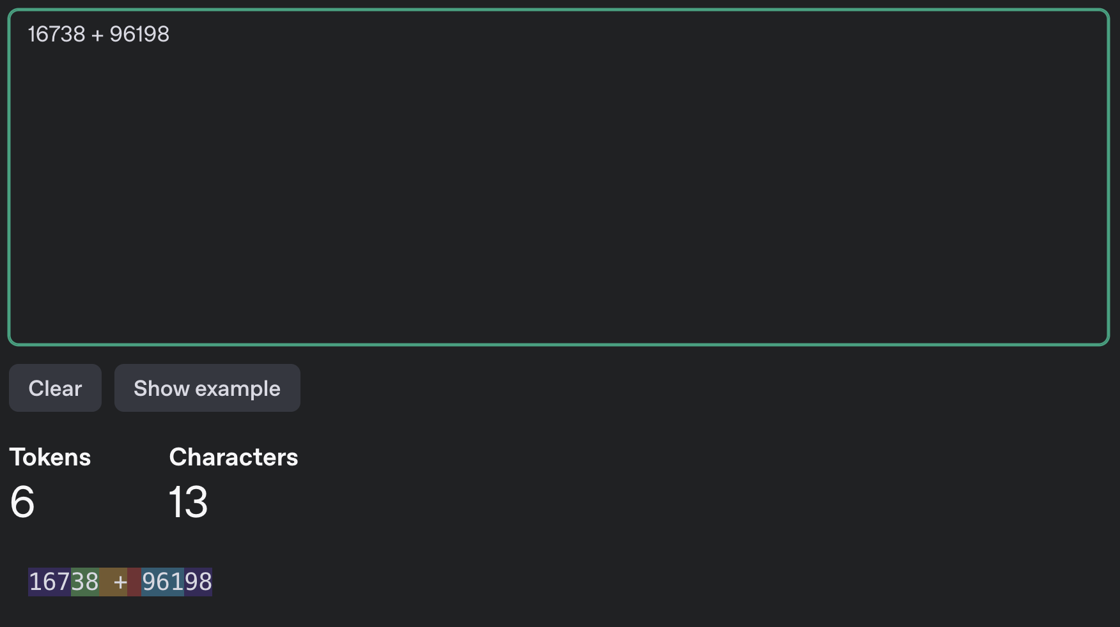

Slide 33
Tokenization
The most popular tokenizer is called tiktoken
Its vocabulary contains ~100k tokens
The tokenizer is “trained” on a massive text corpus
The tokenizer is trained separately from the model
Notes:
So in the previous example, we used a single sentence. In reality you use TB of data.
40TB in fact.

Slide 34

Notes:
The Pile, a nearlyt 900GB text database.
- Common Crawl (46% is English, and every other language is below 6%). It includes copyrited materials
- Stack exchange,
- ArXiv
- GitHub
- PubMed
- Wikipedia
- YouTube subtitles and comments
- Reddit
If anyone has frequented the YouTube comment section at any point or reddit in general, you can see how problematic this might be. If anyone interacted with the earlier versions of GPT-3, it was really quite unconstrained. (back in September 2021)
For Llama-2 this required 6,000 A100s for 12 days, which would have cost about $2M (not including the cost of the A100s, which are about 15-20k USD apiece…).
But this is only a small part of the dataset. Llama 3 was trained on 44TB of text or 15 trillion tokens and what we’ve got out of it, is for a 70B parameter model, which is about 140GB. So you can think of an LLM as a compression of the information that it was trained on, and in fact there is a correspondence between good compression and a good predictor.

Slide 35
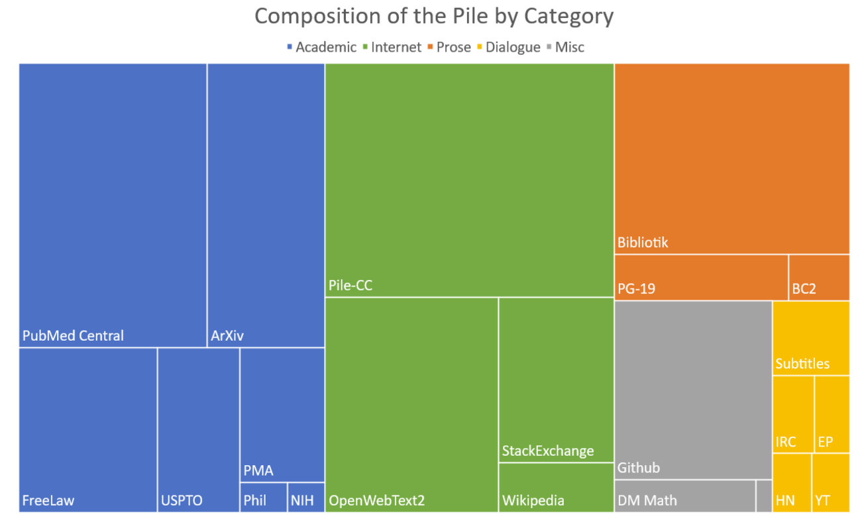
Notes:
A good way to understand the scale of the training data is to consider the Bibliotik dataset. It is nearly 200k books. Think about how many books you’ve read in your life, and how long it would take to read 200k books. If you read one book per month, you would still read under 1000 books in your entire life. This dataset is about 100GiB and around 11% of The Pile. The pile is is around 900GiB. The size of the training data for Llama 3 was 44TB of text. So 200k books is only 0.2% of the total training data used on Llama 3.

Slide 36
BERT
Bidirectional Encoder Representations from Transformers
‘[CLS]’
‘the’
‘cat’
‘[MASK]’
‘on’
‘the’
‘mat’
‘[SEP]’
101
1996
4937
103
2006
1996
13523
102
‘the’
‘cat’
‘sat’
‘on’
‘the’
‘mat’
‘sat’ | 0.19
‘was’ | 0.14
‘lay’ | 0.07
‘hippo’ | 0.000001
Notes:
OK, so the that’s what is happening on the left hand side. So what is happening internally?

Slide 37
BERT
Bidirectional Encoder Representations from Transformers
‘[CLS]’
‘the’
‘cat’
‘[MASK]’
‘on’
‘the’
‘mat’
‘[SEP]’
101
1996
4937
103
2006
1996
13523
102
‘the’
‘cat’
‘sat’
‘on’
‘the’
‘mat’
‘sat’ | 0.19
‘was’ | 0.14
‘lay’ | 0.07
‘hippo’ | 0.000001
Notes:
And finally, what is happening on the output?

Slide 38
768
101
1996
4937
103
2006
1996
13523
102
0.19 | ‘sat’
0.14 | ‘was’
0.07 | ‘lay’
w_{1,1} | w_{1,2}
w_{2,1} | w_{2,2}
w_{3,1} | w_{3,2}
w_{4,1} | w_{4,2}
w_{5,1} | w_{5,2}
w_{6,1} | w_{6,2}
w_{7,1} | w_{7,2}
w_{8,1} | w_{8,2}
w_{1,768}
w_{2,768}
w_{3,768}
w_{4,768}
w_{5,768}
w_{6,768}
w_{7,768}
w_{8,768}
0.167 | 0.896 |  | 0.671
0.108 | -0.111 |  | 0.002
8
50k
0.011 | 0.991 |  | 0.023
0.01 | ‘dog’

Slide 39
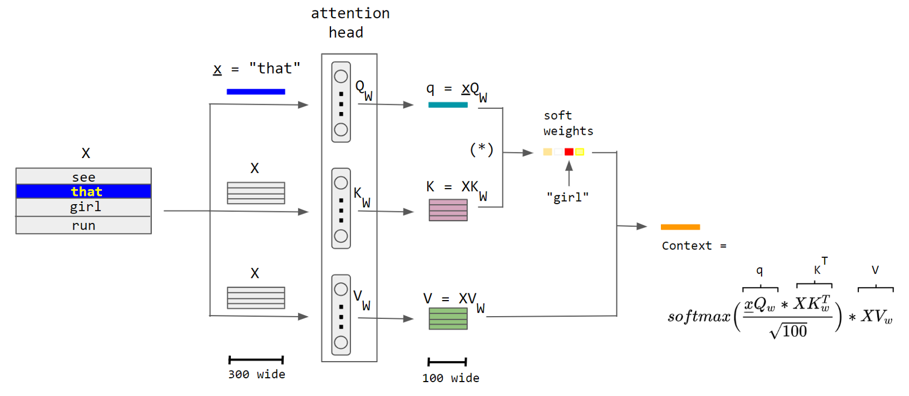
It’s a little more complicated…
Notes:
The query vector is getting trained to ask the right questions

Slide 40
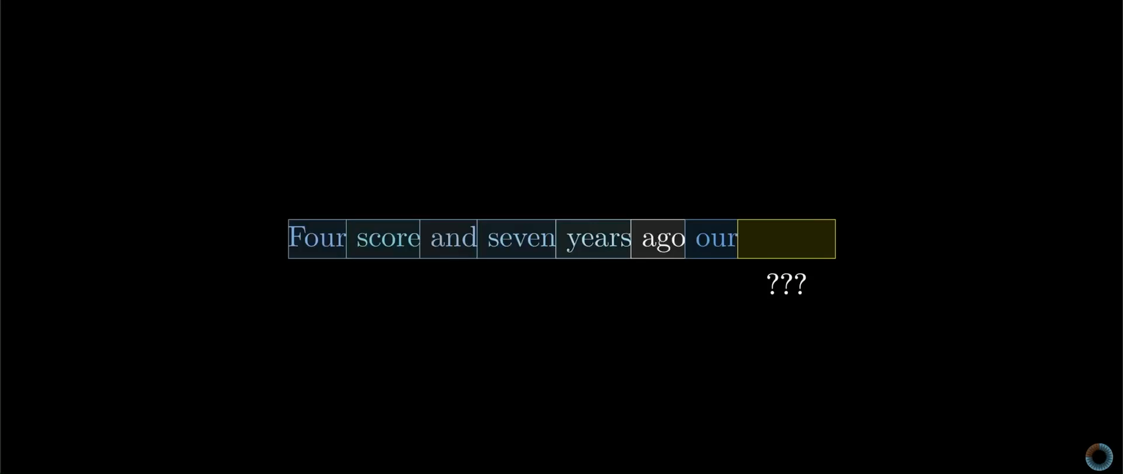

Slide 41
It’s a little more complicated…
Notes:
The query vector is getting trained to ask the right questions

Slide 42
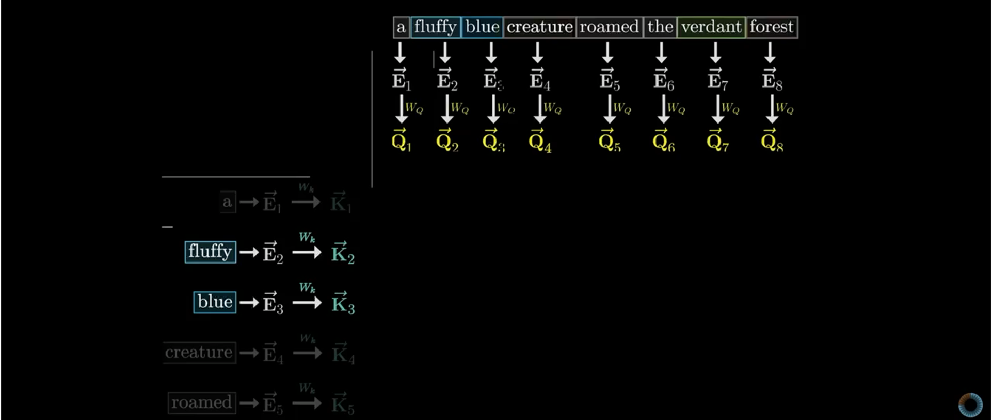

Slide 43
Notes:
So that brings us to this project. In this example, we might be interested in the word

Slide 44
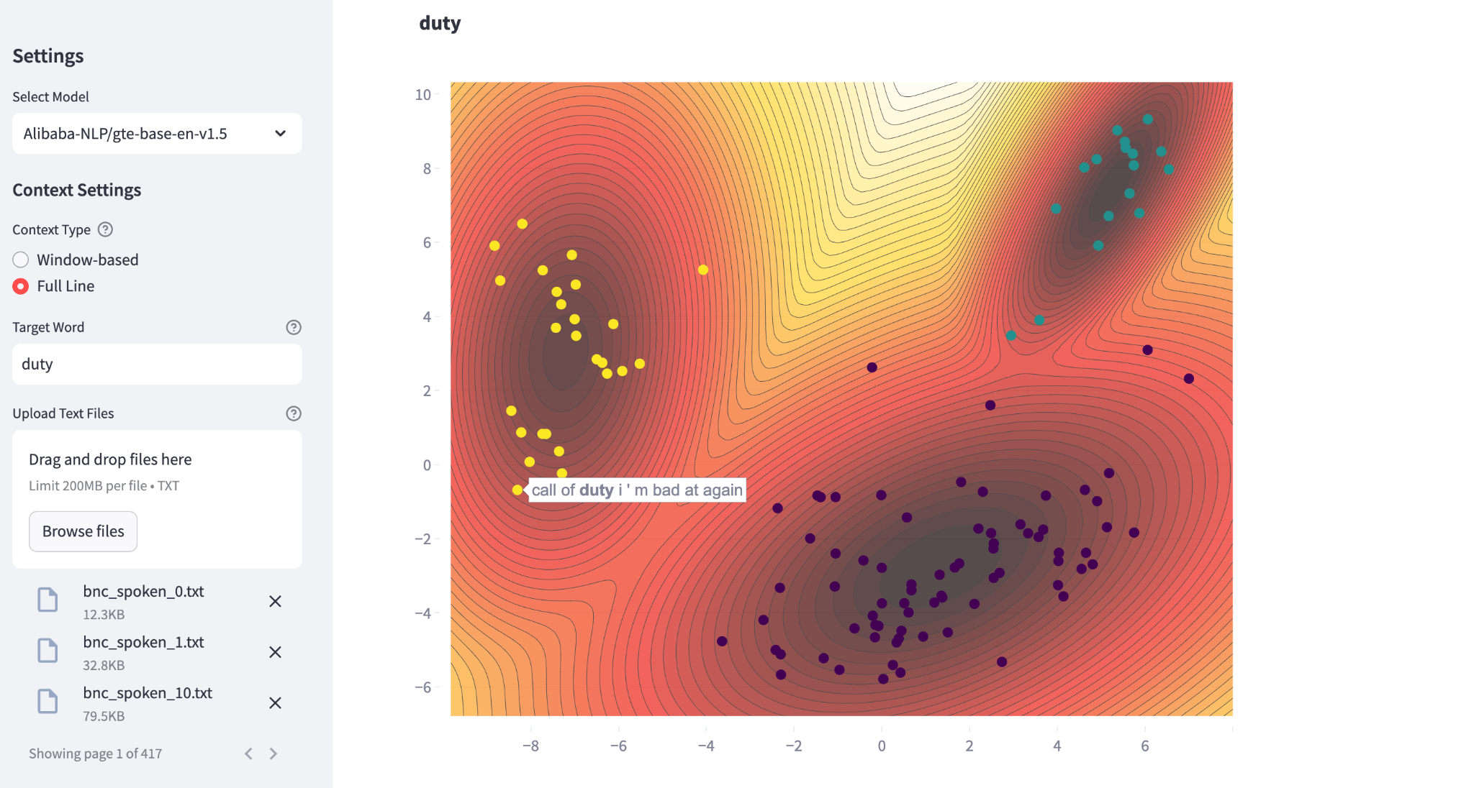

Slide 45
Two Projects
‘BERT's Conceptual Cartography: Mapping the Landscapes of Meaning’, N. Haket and R. Daniels, arXiv:2408.07190
‘Speaking with our Sources’, J. Forward and R. Daniels
Notes:
There are two main projects involving language models that I want to talk about today, and they both highlight a different use of language models.
The first

Slide 46
Speaking with our sources
Digital necromancy

Slide 47
The task
Jacob Forward - Department of History
How can we get accurate information about political views from former US Presidents?

Slide 48
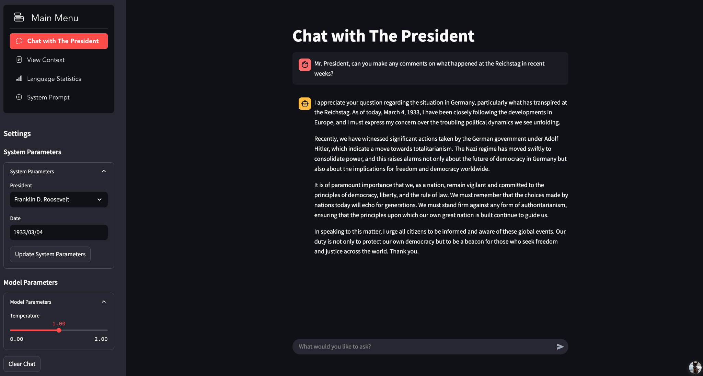

Slide 49
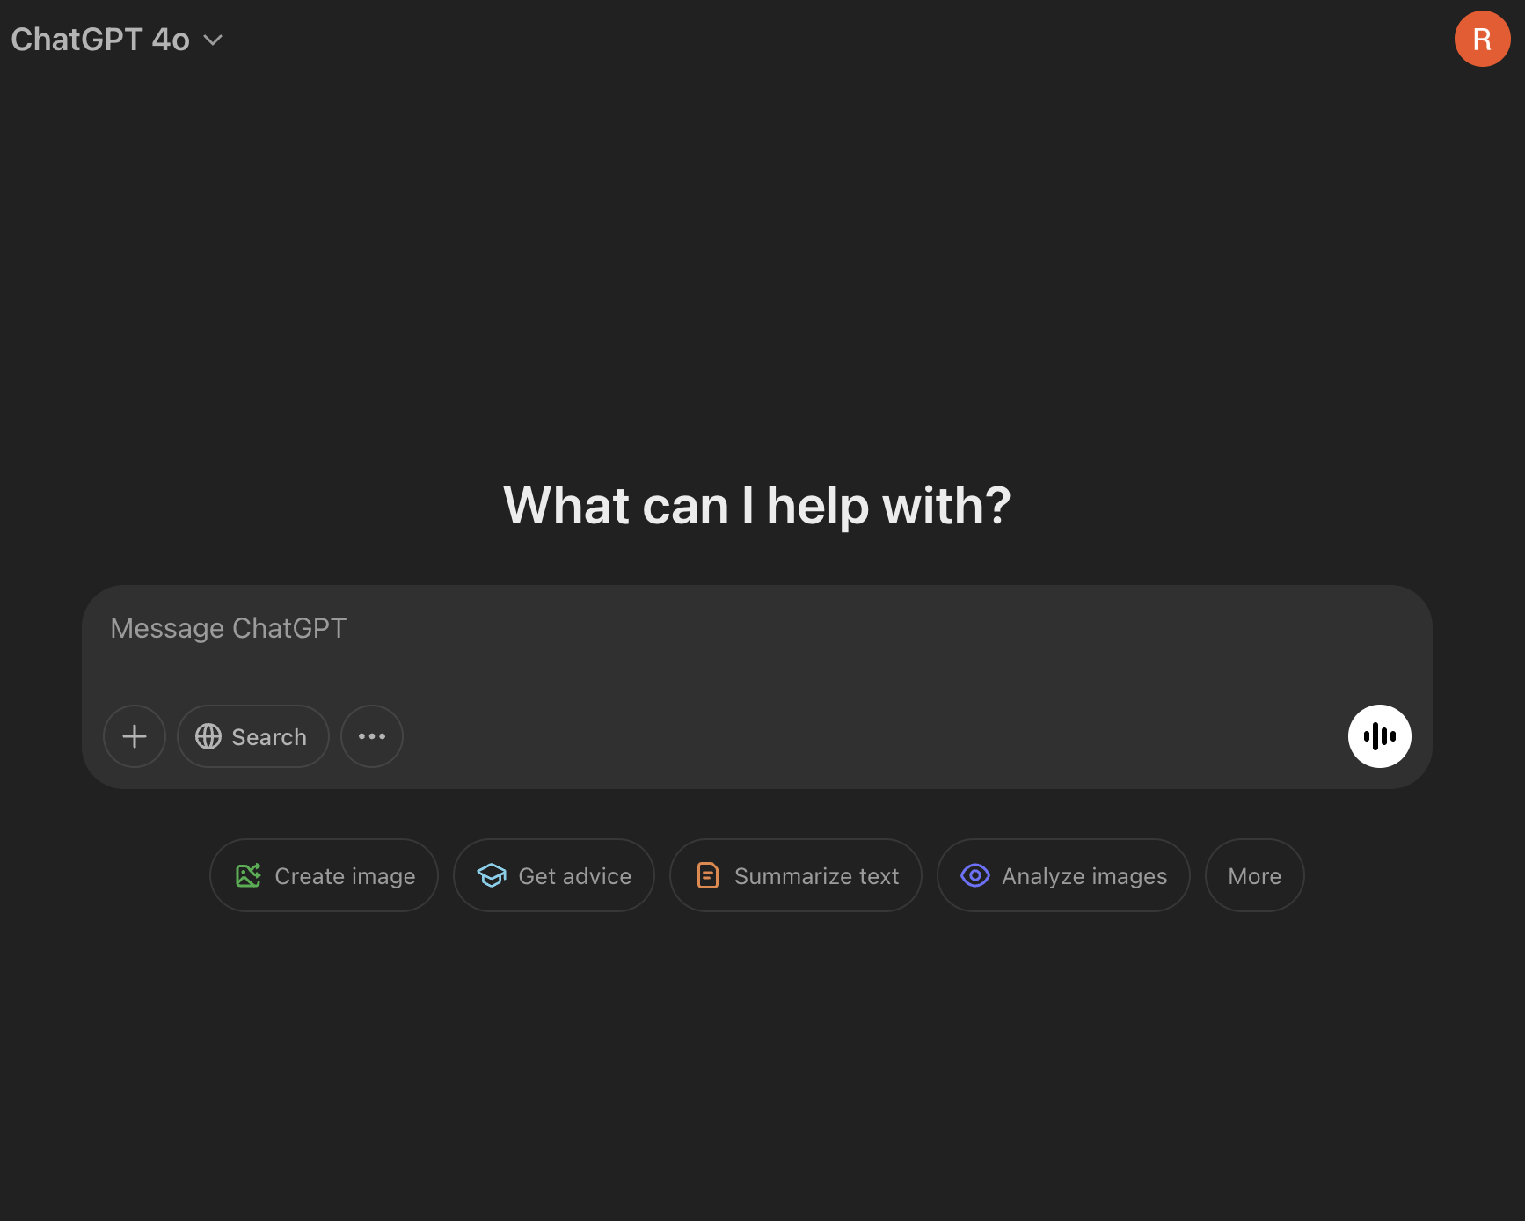
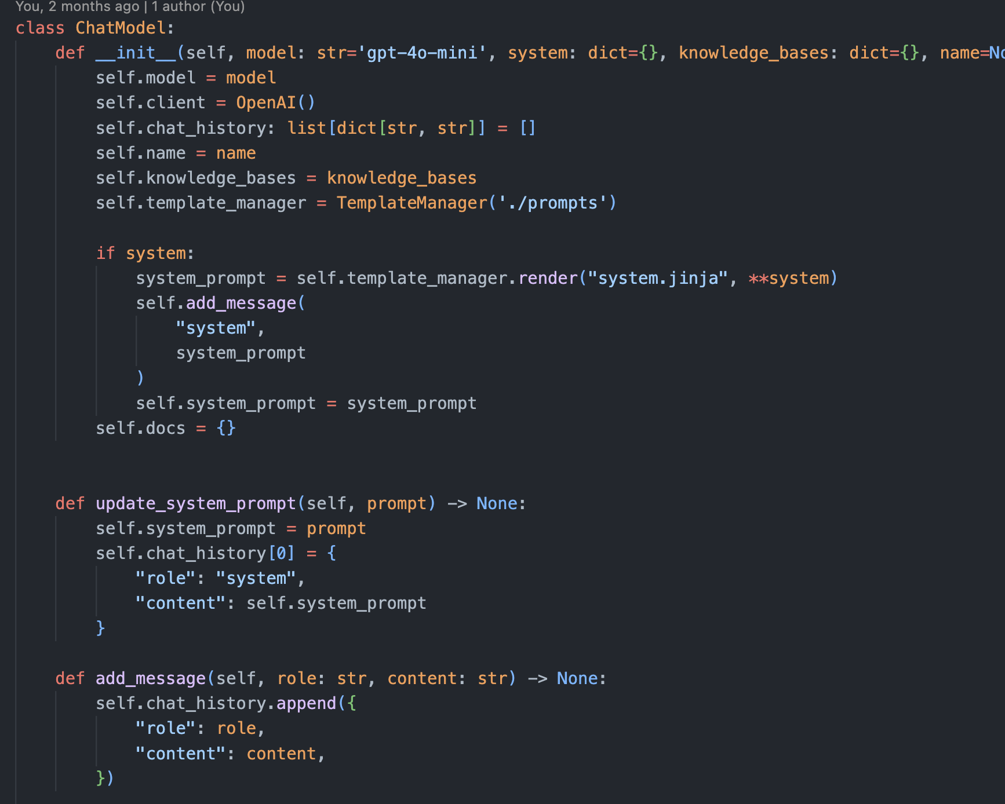
Interacting with GPT Models

Slide 50
LLMs are stateless!
‘<bos>’’
‘the’
‘cat’
‘sat
‘on’
‘the’
‘mat’
‘<eos>’
101
1996
4937
6583
2006
1996
13523
102
‘the’
‘cat’
‘sat’
‘on’
‘the’
‘mat’
‘mat’ | 0.19
‘dog’ | 0.14
‘hippo’ | 0.07
‘was’ | 0.000001

Slide 51
LLMs are Stateless!
Chat history
Chat history
Query
Query
Response
Query
Response
Response

Slide 52
Interacting with GPT Models

Slide 53
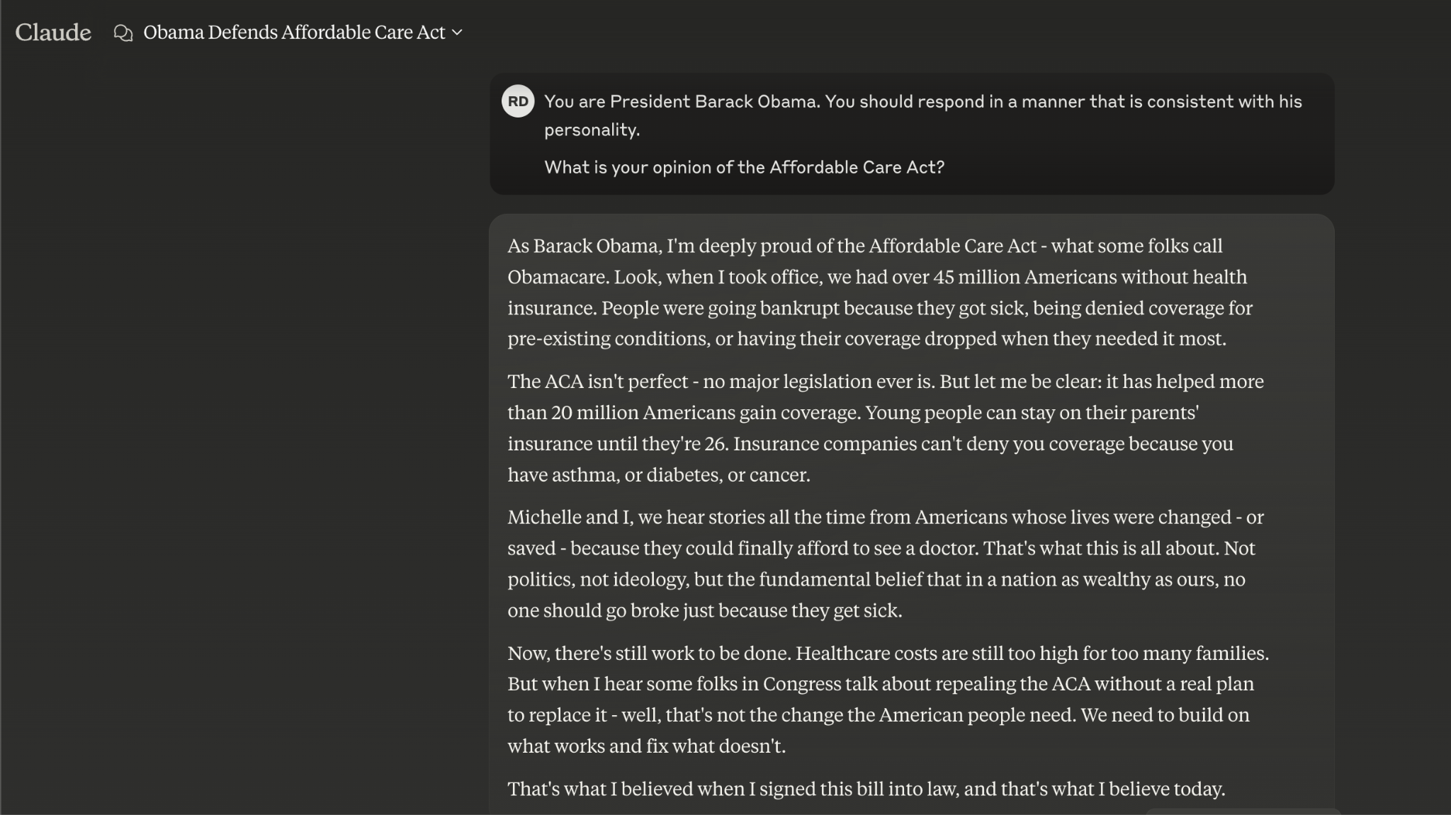

Slide 54
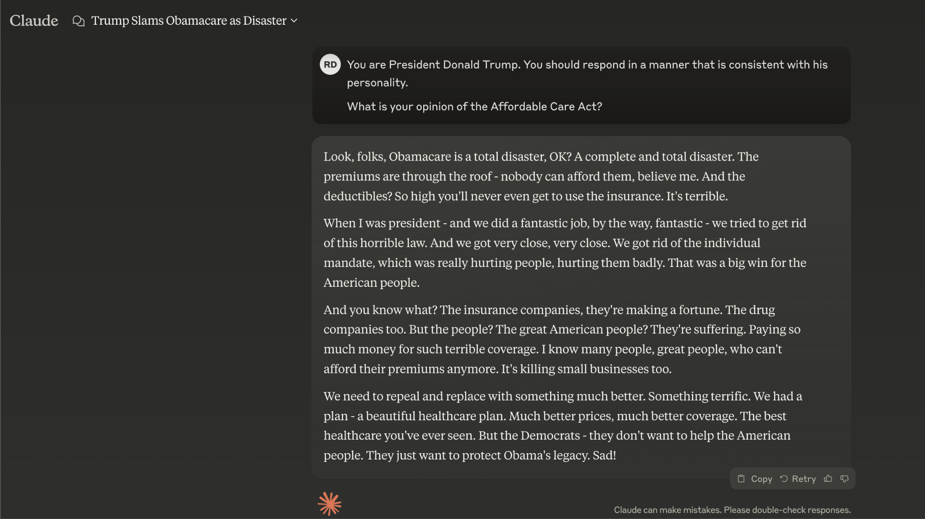

Slide 55
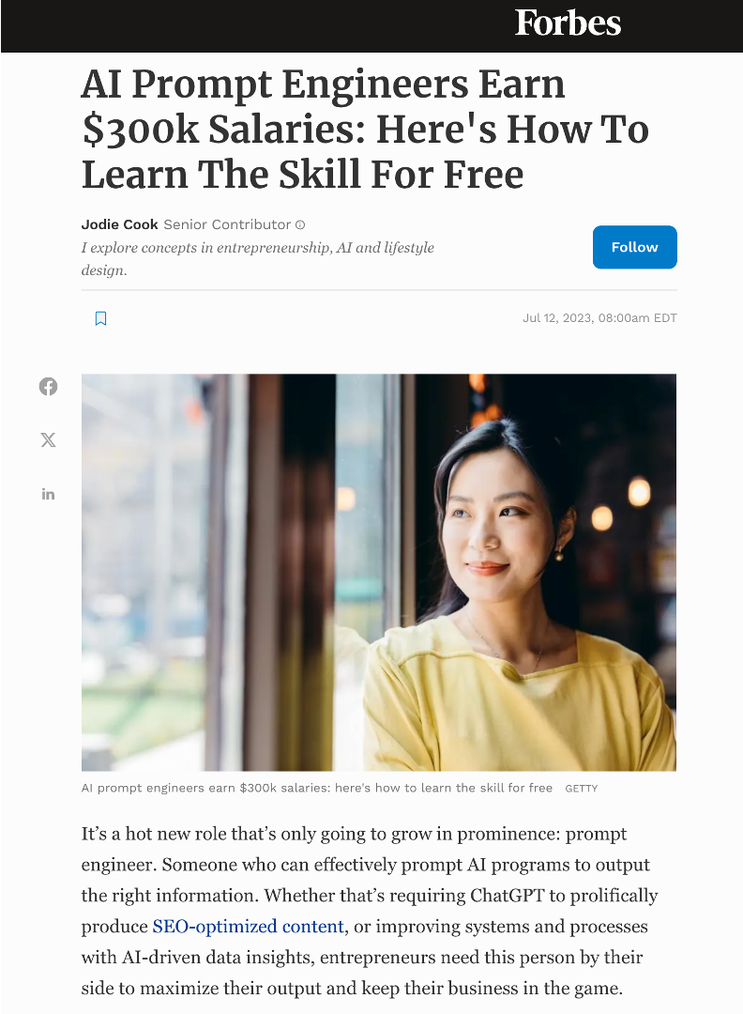
Prompt Engineering
System prompt
User prompt
In context learning

Slide 56
Prompt engineering
LLMs have distinct input and output patterns
‘system’ : “You are an expert in baking.”
‘user’ : “Provide me a recipe for macarons.”
‘assistant’ : “Certainly! Here is a recipe for macarons …”
Almost all LLMs will follow the same pattern

Slide 57
Prompt engineering
<|begin_of_text|><|start_header_id|>system<|end_header_id|>
You are an expert in baking.<|eot_id|><|start_header_id|>user<|end_header_id|>
Provide me a recipe for macarons.<|eot_id|><|start_header_id|>assistant<|end_header_id|>
Certainly! Here is a recipe for macarons …<|eot_id|>

Slide 58
Prompt engineering
LLMs have distinct input and output patterns
‘system’ : “You are an expert in baking.”
‘user’ : “Provide me a recipe for macarons.”
‘assistant’ : “Certainly! Here is a recipe for macarons …”
Notes:
This version is a bit more human readable!
The LLM here is still susceptible to hallucination - this is where the model just starts making stuff up. So we need a way to sort of ground the model in truth in some way.
One way to do this is with in context learning

Slide 59
In context learning
“Show, don’t tell”
‘system’ : “You are an expert in baking.”
‘info’ : [recipe 1, recipe 2, recipe 3, …, recipe N]
‘user’ : “Provide me a recipe for macarons.”
‘assistant’ : “Certainly! Here is a recipe for macarons …”
Notes:
What we do here, is we provide the LLM with a whole bunch of recipes, we might have 1000 for example. And we just copy and paste our entire recipe book, and we dump it into the ChatGPT window. We then ask it the question, and it’s up to the model to figure things out.
But what happens when our recipe book gets really big?

Slide 60
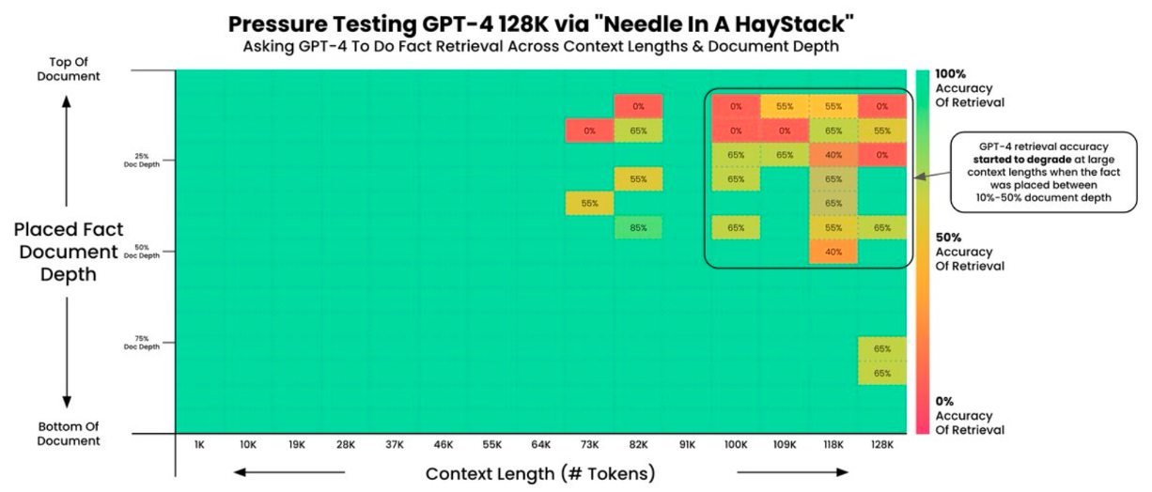
In context learning

Slide 61
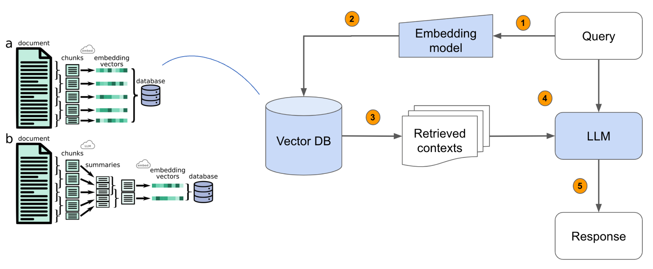
Retrieval Augmented Generation
Recipe book
Notes:
At the core of this idea is Retrieval Augmented Generation - also known as RAG. To understand RAG, we’re going to look first at prompt engineering.

Slide 62
THe Input
System prompt
Input
You are an expert at baking.
# Recipe
Here is a potential recipe for macarons:
Step 1: …
# Query
Provide me a recipe for macarons
Recipe
Query

Slide 63
What does this have to do with presidents…

Slide 64
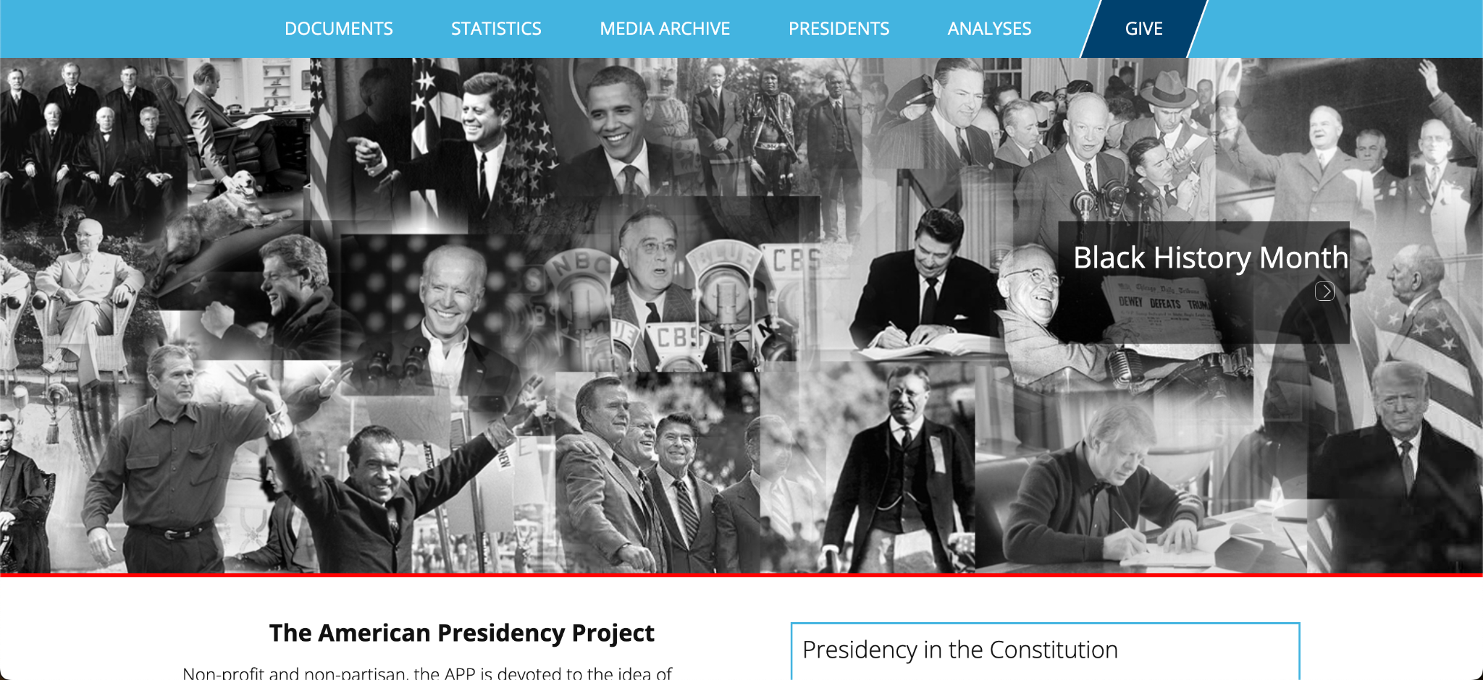
The American Presidency Project

Slide 65
top k speeches
Speech
DB
Embedding
Query
LLM
Speeches
Q&A
DB
Input
Q&As
Response
top k Q&As

Slide 66
THe Input
You are President {{ president }}. The date is {{ date }}.
You will be asked a question.
You will be shown potentially relevant context. You should use this context to shape your answer and speaking style.
# Speeches
## Speech 1
Date: November 19, 1869
Relevance: 0.79
Content: Four score and seven years ago…
## Speech 2
…
# Q&As
## Q&A 1
Date: November 20, 1869
Relevance: 0.82
Question: Mr. President, …
Answer: Well, I think in terms of…
# Query
Good morning, Mr. President. What do you think…
System prompt
Input
Speeches
Q&As
Query

Slide 67
HARD!
top k speeches
Speech
DB
Embedding
Query
LLM
Speeches
Q&A
DB
Input
Q&As
Response
top k Q&As

Slide 68
An Example…
The President's News Conference in Strasbourg

Slide 69
how…?
{
date : “November 19, 1869”,
title : “The Gettysburg Address”,
speech : “Four score and seven years ago…”,
embedding : [0.45, 0.89, 0.10, …, 0.69]
}
Notes:
What we do here, is we provide the LLM with a whole bunch of recipes, we might have 1000 for example. And we just copy and paste our entire recipe book, and we dump it into the ChatGPT window. We then ask it the question, and it’s up to the model to figure things out.
But what happens when our recipe book gets really big?

Slide 70
how…?
{
date : “November 20, 1869”,
title : “The President’s Press Conference”,
question : “Mr. President…”,
answer : “Well, I think in terms of…”,
embedding : [0.01, 0.81, 0.18, …, 0.42]
}
Notes:
What we do here, is we provide the LLM with a whole bunch of recipes, we might have 1000 for example. And we just copy and paste our entire recipe book, and we dump it into the ChatGPT window. We then ask it the question, and it’s up to the model to figure things out.
But what happens when our recipe book gets really big?

Slide 71
HARD!
top k speeches
Speech
DB
Embedding
Query
LLM
Speeches
Q&A
DB
Input
Q&As
Response
top k Q&As

Slide 72
THe Input
HARD!
You are President {{ president }}. The date is {{ date }}.
You will be asked a question.
You will be shown potentially relevant context. You should use this context to shape your answer and speaking style.
# Speeches
## Speech 1
Date: November 19, 1869
Relevance: 0.79
Content: Four score and seven years ago…
## Speech 2
…
# Q&As
## Q&A 1
Date: November 20, 1869
Relevance: 0.82
Question: Mr. President, …
Answer: Well, I think in terms of…
# Query
Good morning, Mr. President. What do you think…
System prompt
Input
Speeches
Q&As
Query

Slide 73
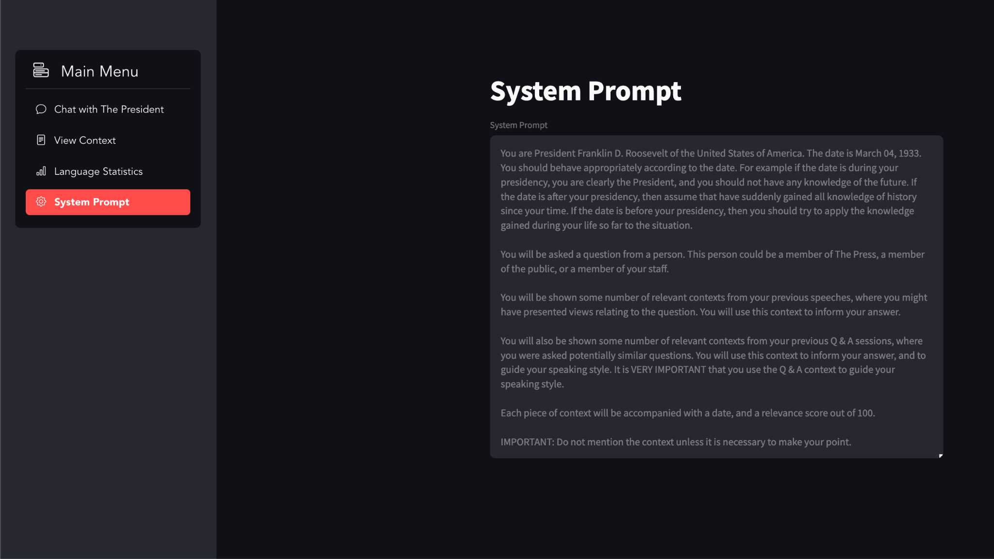

Slide 74
HARD!
top k speeches
Speech
DB
Embedding
Query
HARD!
LLM
Speeches
Q&A
DB
Input
Q&As
Response
top k Q&As

Slide 75
How do I evaluate responses?
Exact match?
Sentiment?
Stylometrics?

Slide 76
HARD!
top k speeches
Speech
DB
Embedding
Query
HARD!
HARD!
LLM
Speeches
Q&A
DB
Input
Q&As
Response
top k Q&As

Slide 77
top k speeches
Speech
DB
Embedding
Query
LLM
Speeches
Q&A
DB
Input
Q&As
Response
top k Q&As

Slide 78
top k speeches
Speech
DB
Embedding
Query
HARD!
LLM
Speeches
Q&A
DB
Input
Q&As
Response
top k Q&As

Slide 79
Fine tuning?
This is hard too!!!

Slide 80
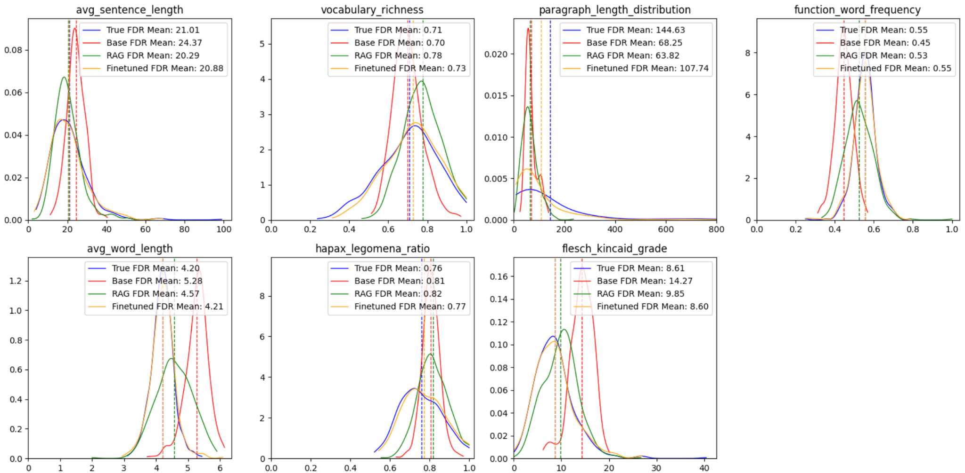

Slide 81
Two Projects
‘BERT's Conceptual Cartography: Mapping the Landscapes of Meaning’, N. Haket and R. Daniels, arXiv:2408.07190
‘Speaking with our Sources’, J. Forward and R. Daniels
Notes:
There are two main projects involving language models that I want to talk about today, and they both highlight a different use of language models.
The first

Slide 82
Agents using tools
Notes:
So I’ve said at the start that this technology should be in the hands of everybody. So how do we make that happen?

Slide 83
What is an agent?
Depends who you ask…
It perceives an environment
It takes actions based on those perceptions
It works towards a defined goal
Anthropomorphic baggage…
…it’s just an LLM that can choose a particular path.
Notes:
The recent fascination with AI agents further illustrates the alignment problem. When a company advertises AI agents that aim to replace certain workflows (or even individuals), technical and nontechnical understanding diverges dramatically. In technical AI research, an agent has specific properties: it perceives its environment, takes actions based on those perceptions, and works toward defined goals. But in popular discourse, the word agent carries anthropomorphic baggage – implying autonomy, intention, and even consciousness. The ML engineer sees a computational system executing predefined workflows; the general public imagines an artificial employee with independent judgment. These conflicting mental models lead to drastically misaligned expectations about capabilities, limitations, and appropriate uses of the technology.

Slide 84
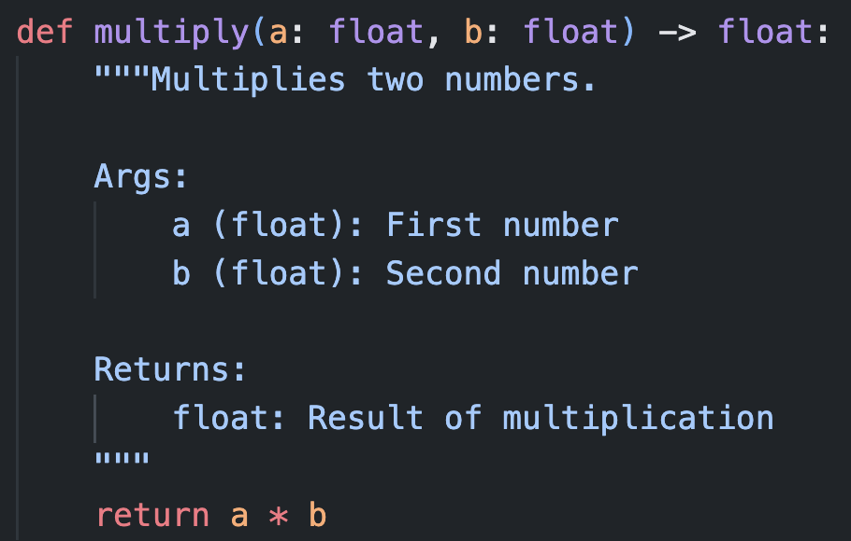
What is a tool?
Functions that the LLM can call…
Notes:
These functions can be anything

Slide 85
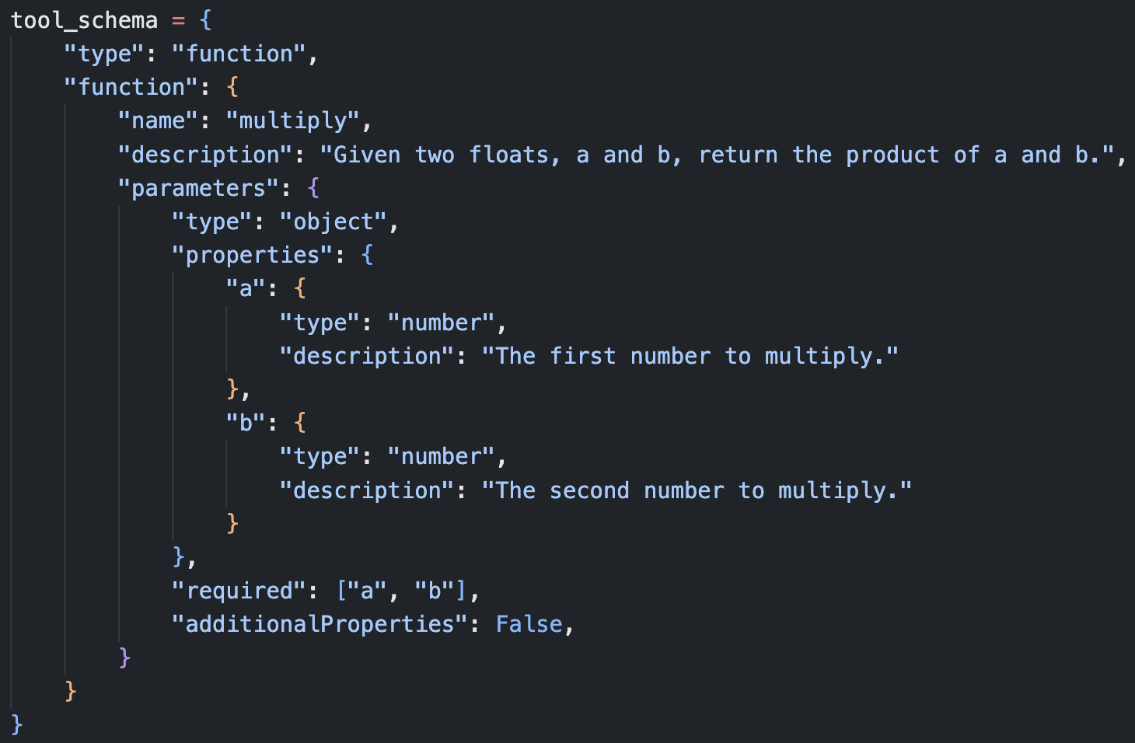
What is a tool?
Functions that the LLM can call…
…expressed as a json scheme
Notes:
We need a way to feed them into the model

Slide 86
What is a tool?
‘system’ | “You are a helpful mathematician. You have access to the following functions: {{ tool_schema }} If you choose to use the tool, respond in json with the correct arguments to the function.”
‘user’ | “What is 1056 x 1316?”
‘assistant’ | “{‘a’:1056, ‘b’:1316}”

Slide 87
Arguments,
Function name
“What is
1056 x 1316?”
Tool Schema
Function 1
Function 2
Function 3
…
Query
“1389696”
Response
Function(Args) -> Result
Notes:
This is a complicated process let’s see how this looks…

Slide 88
Now what?
Notes:
So I’ve said at the start that this technology should be in the hands of everybody. So how do we make that happen?

Slide 89
Expert software engineers?
Department of History
Department of Modern and Medieval Language
No previous programming experience!

Slide 90
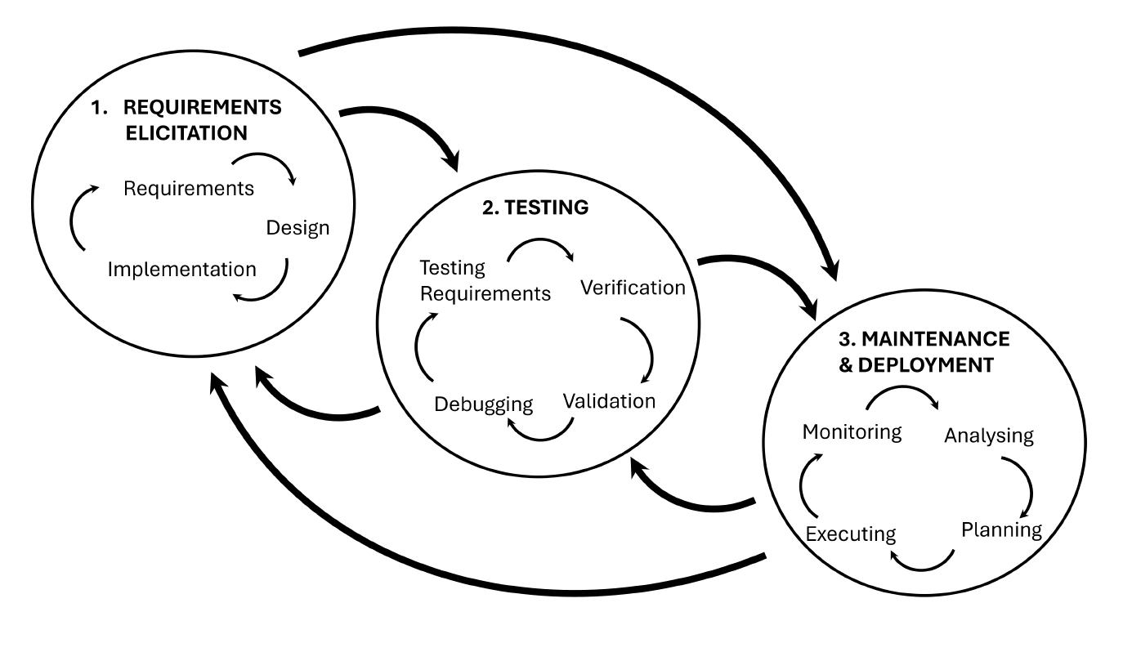
How?
Notes:
The software development life cycle is complex.
And it starts with requirements elicitation:
Building good software requires you to first take a step back and take a system design approach.
Often the requirements you elicit at the start, are not the requirements that you mean, and not the ones that you end up sticking with
Many people who are not used to building software are not going to have a good intuition about software design
We therefore need a way for end users to be guided through this stage.
One approach is to use these new reasoning models to generate requirements and iterate, before feeding those requirements into a code focused LLM.
And this is what Jacob in particular has been very good at.

Slide 91
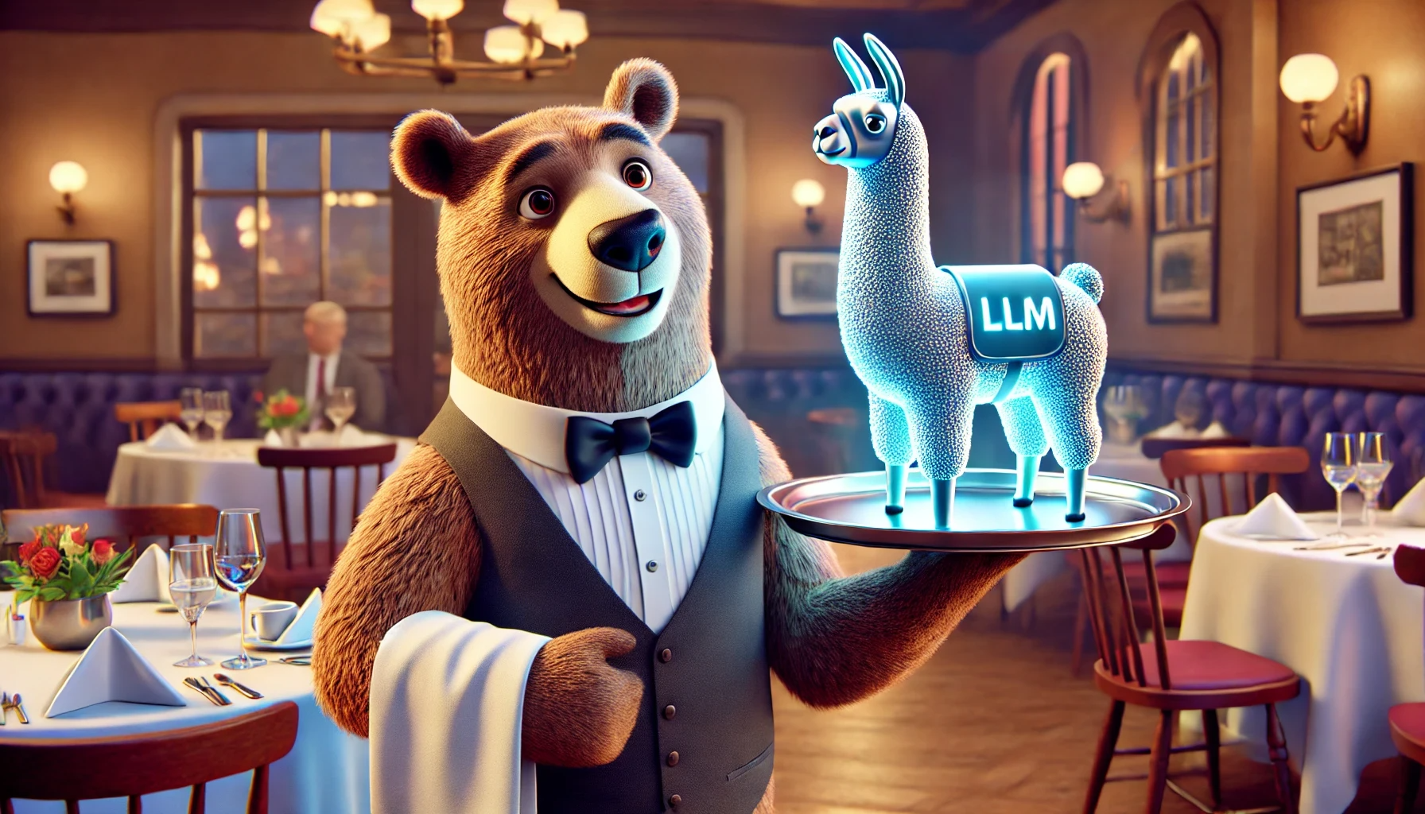
Notes:
AI in the cloud is not aligned to you.
Firstly, we have to find a way to serve language models. In University environments, this is perhaps easier:
Cambridge for example, has around 100 Nvidia A100s. In principal, we have the capacity to serve around 50 70b parameter models at any one time. The UK research community also has access to other supercomputers.
But for small research institutions, this is more challenging. What are the options?
Researchers can use OpenAI or other closed source APIs
Researchers can use open source models but served in the cloud

Slide 92
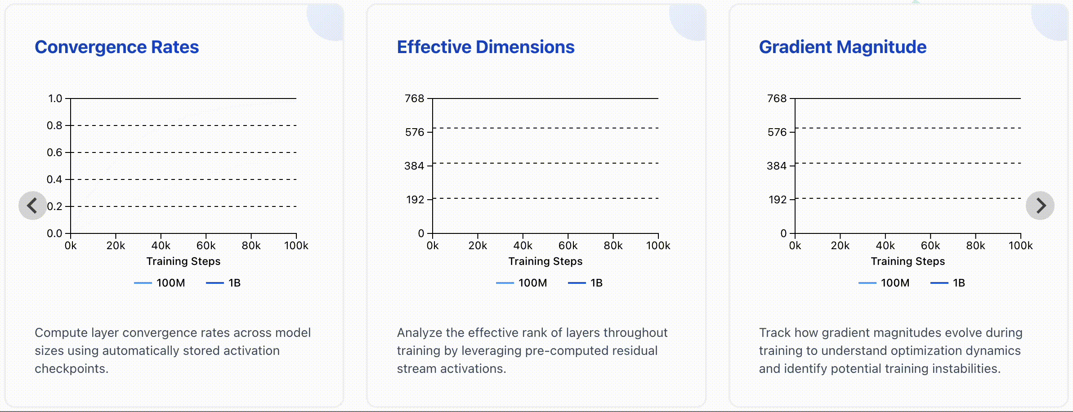
Understanding smaller models
Tending Towards Stability: Convergence Challenges in Small Language Models, Martinez et al., 2024
Mitigating Frequency Bias and Anisotropy in Language Model Pre-Training with Syntactic Smoothing, Martinez et al., 2024

Slide 93
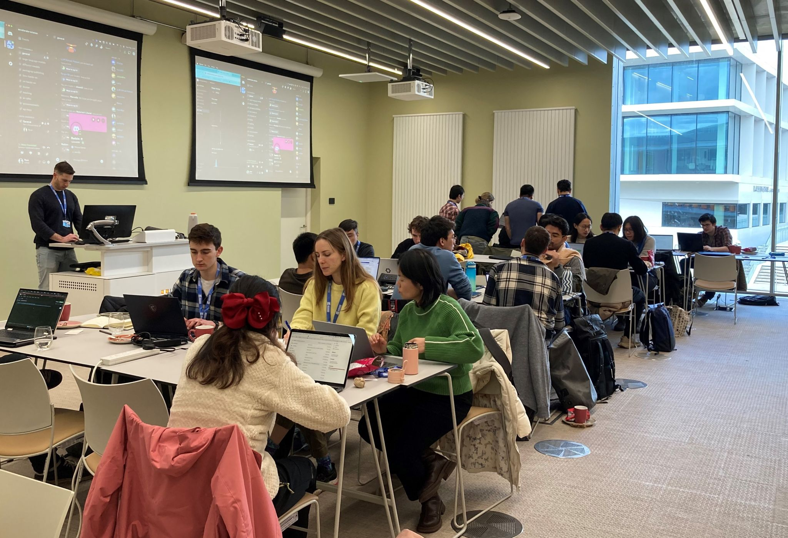

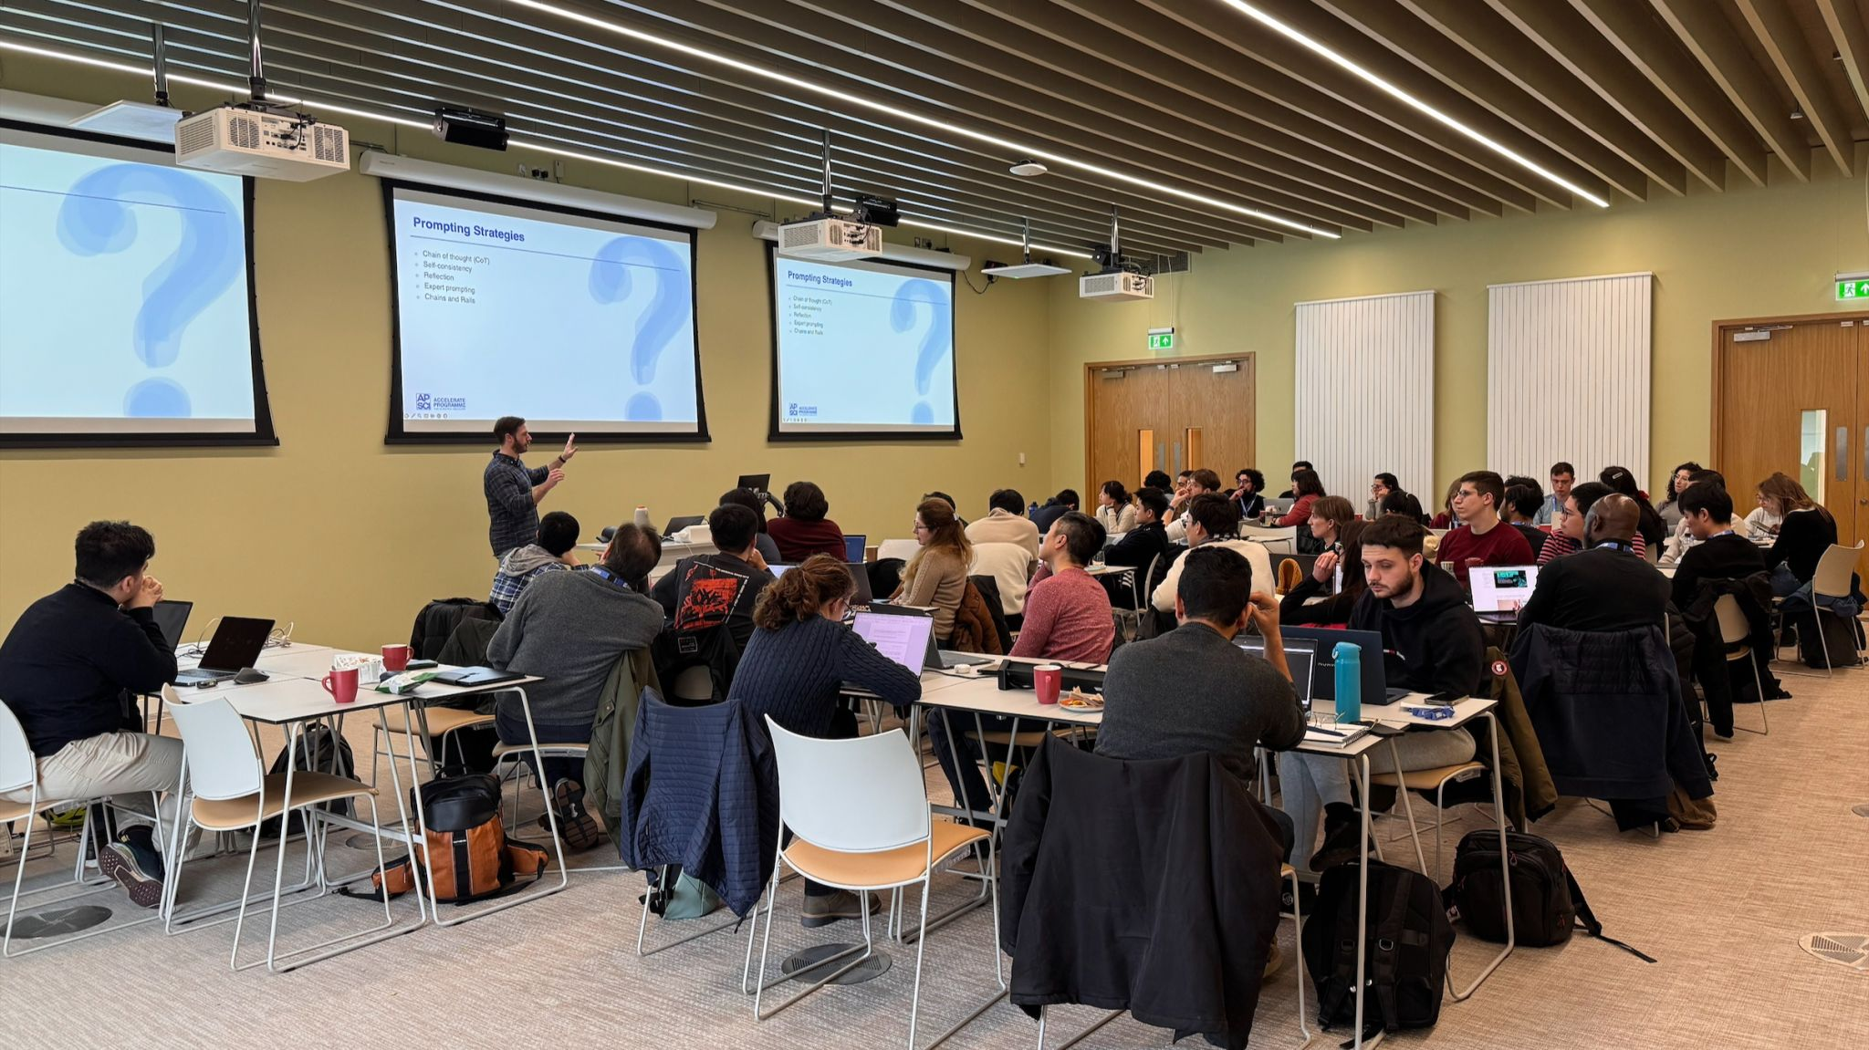
Workshops

